Slide 1
VllSION 200 SOURCE HEAD
Maintenance Assembly Reference
IMPLANTER-Diffusion Department
Prepare By: SAMUEL 山姆爾 SaSPAREDOC.06

Slide 2
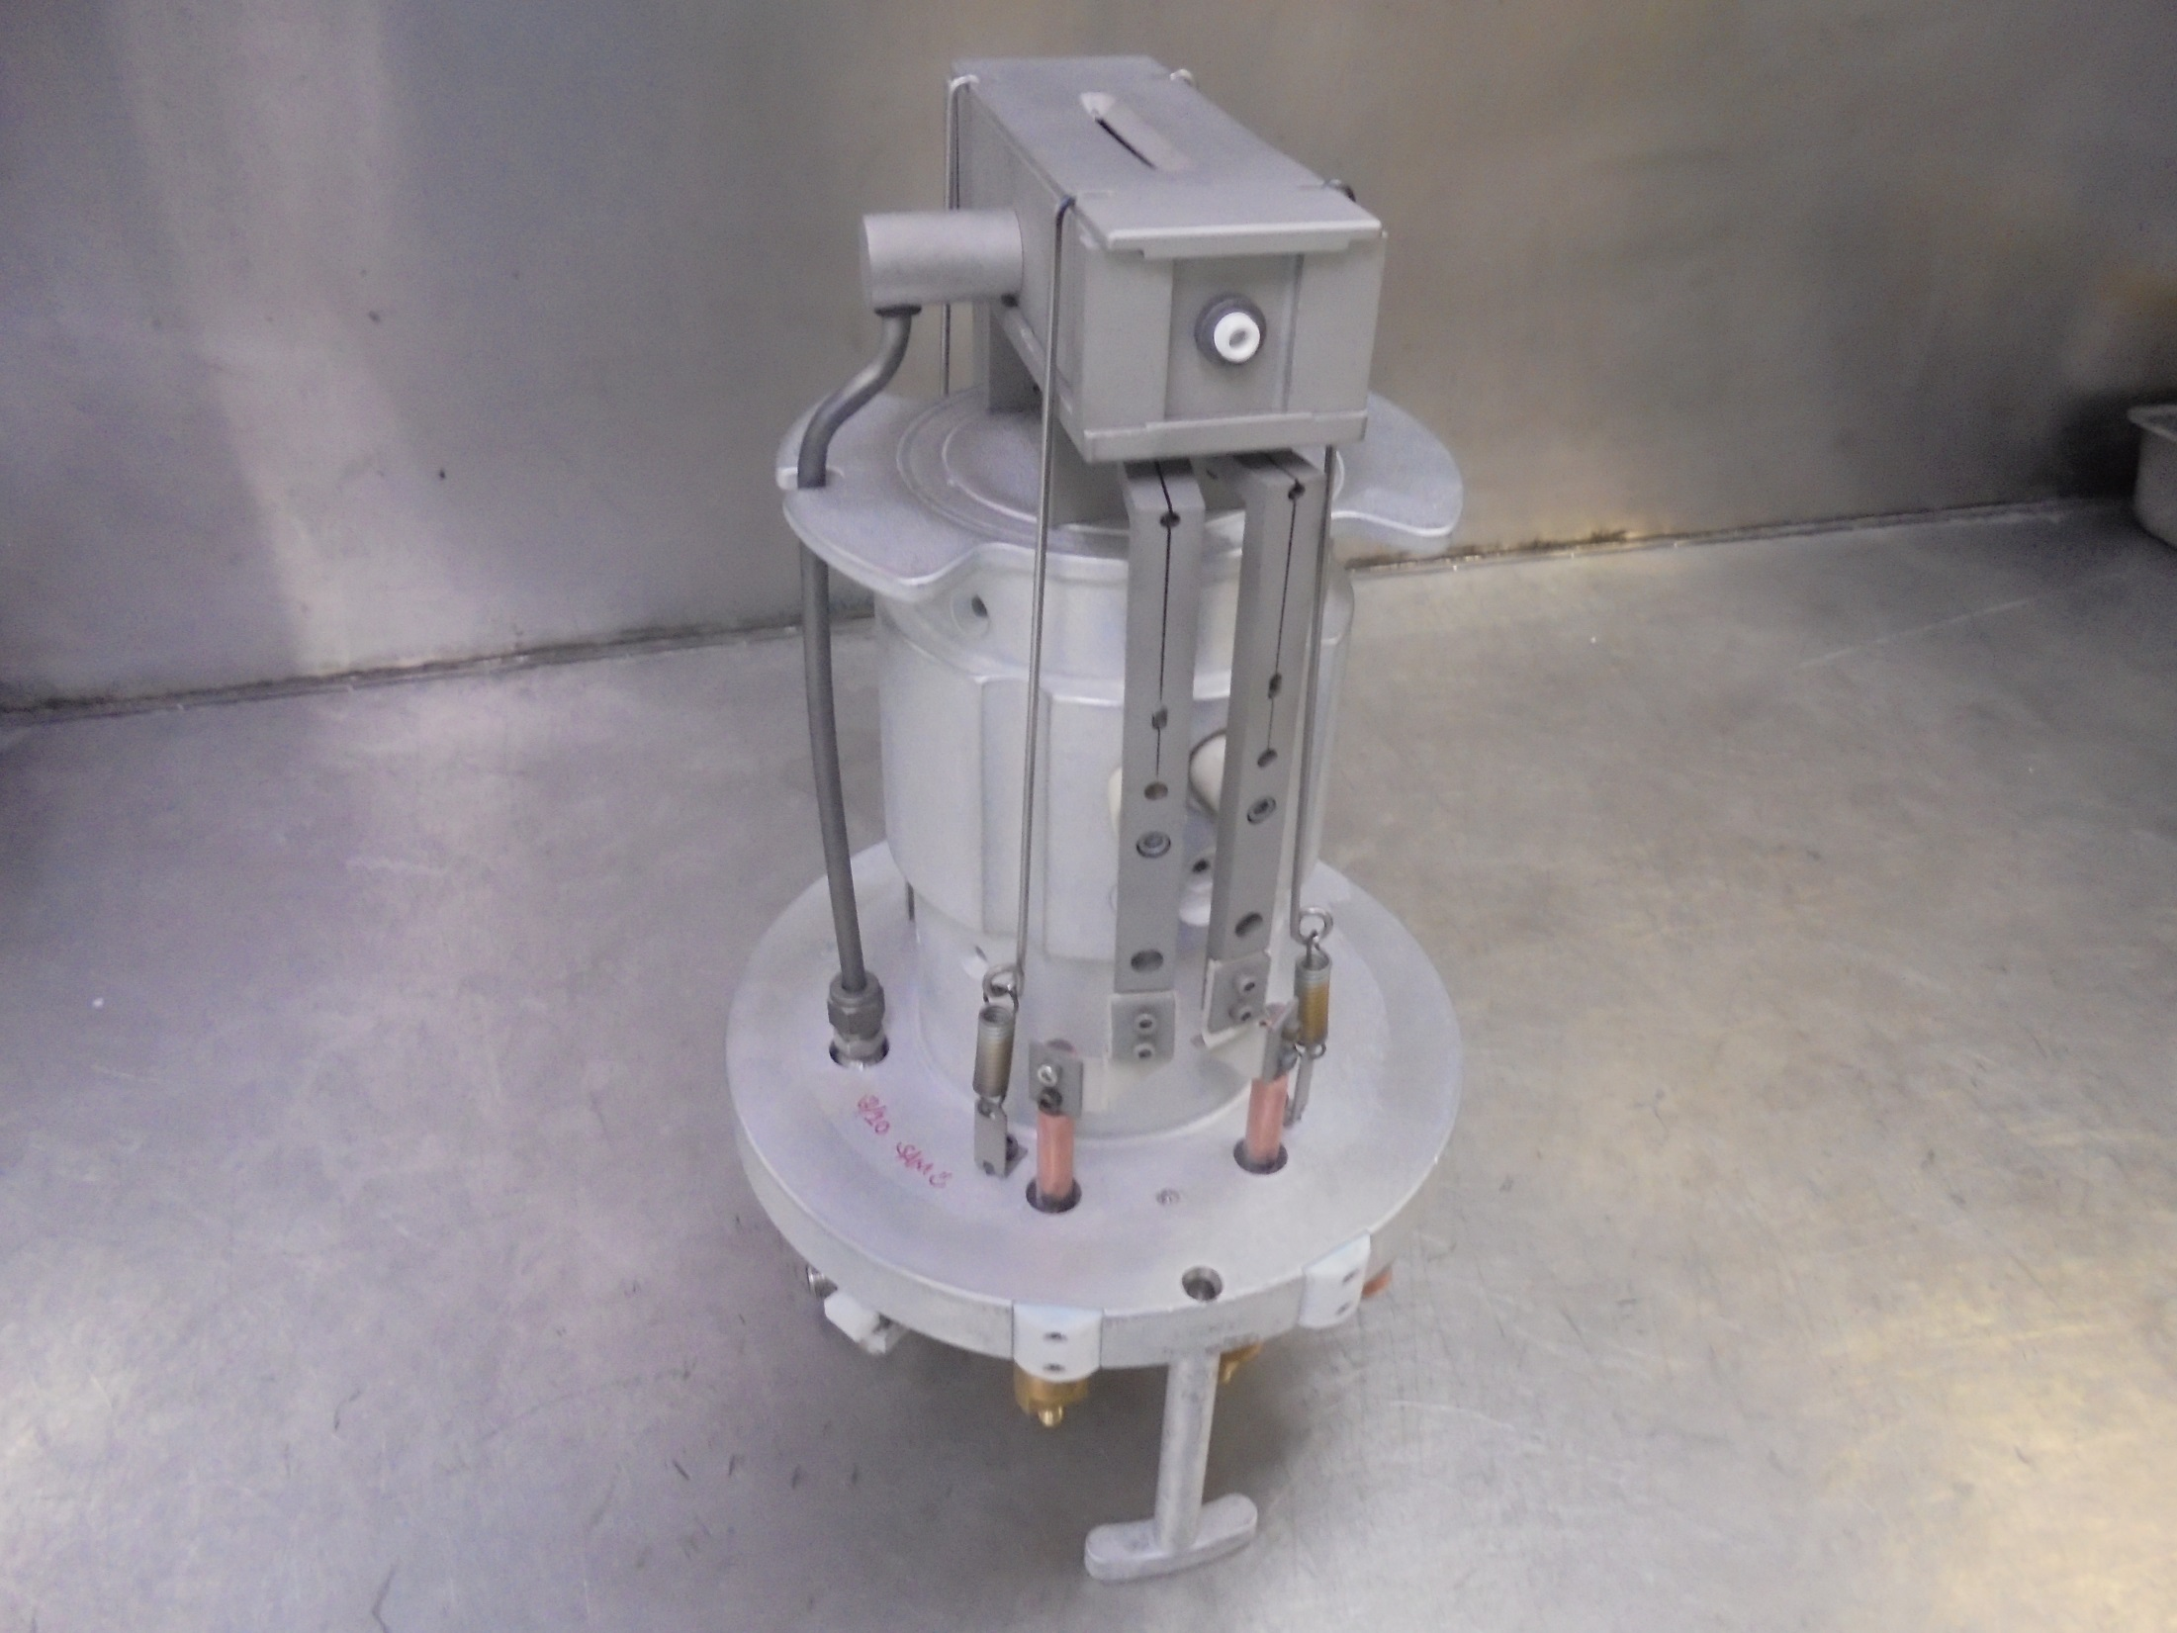
VIIsion 200 SOURCE HEAD

Slide 3
Consumable Parts

Slide 4
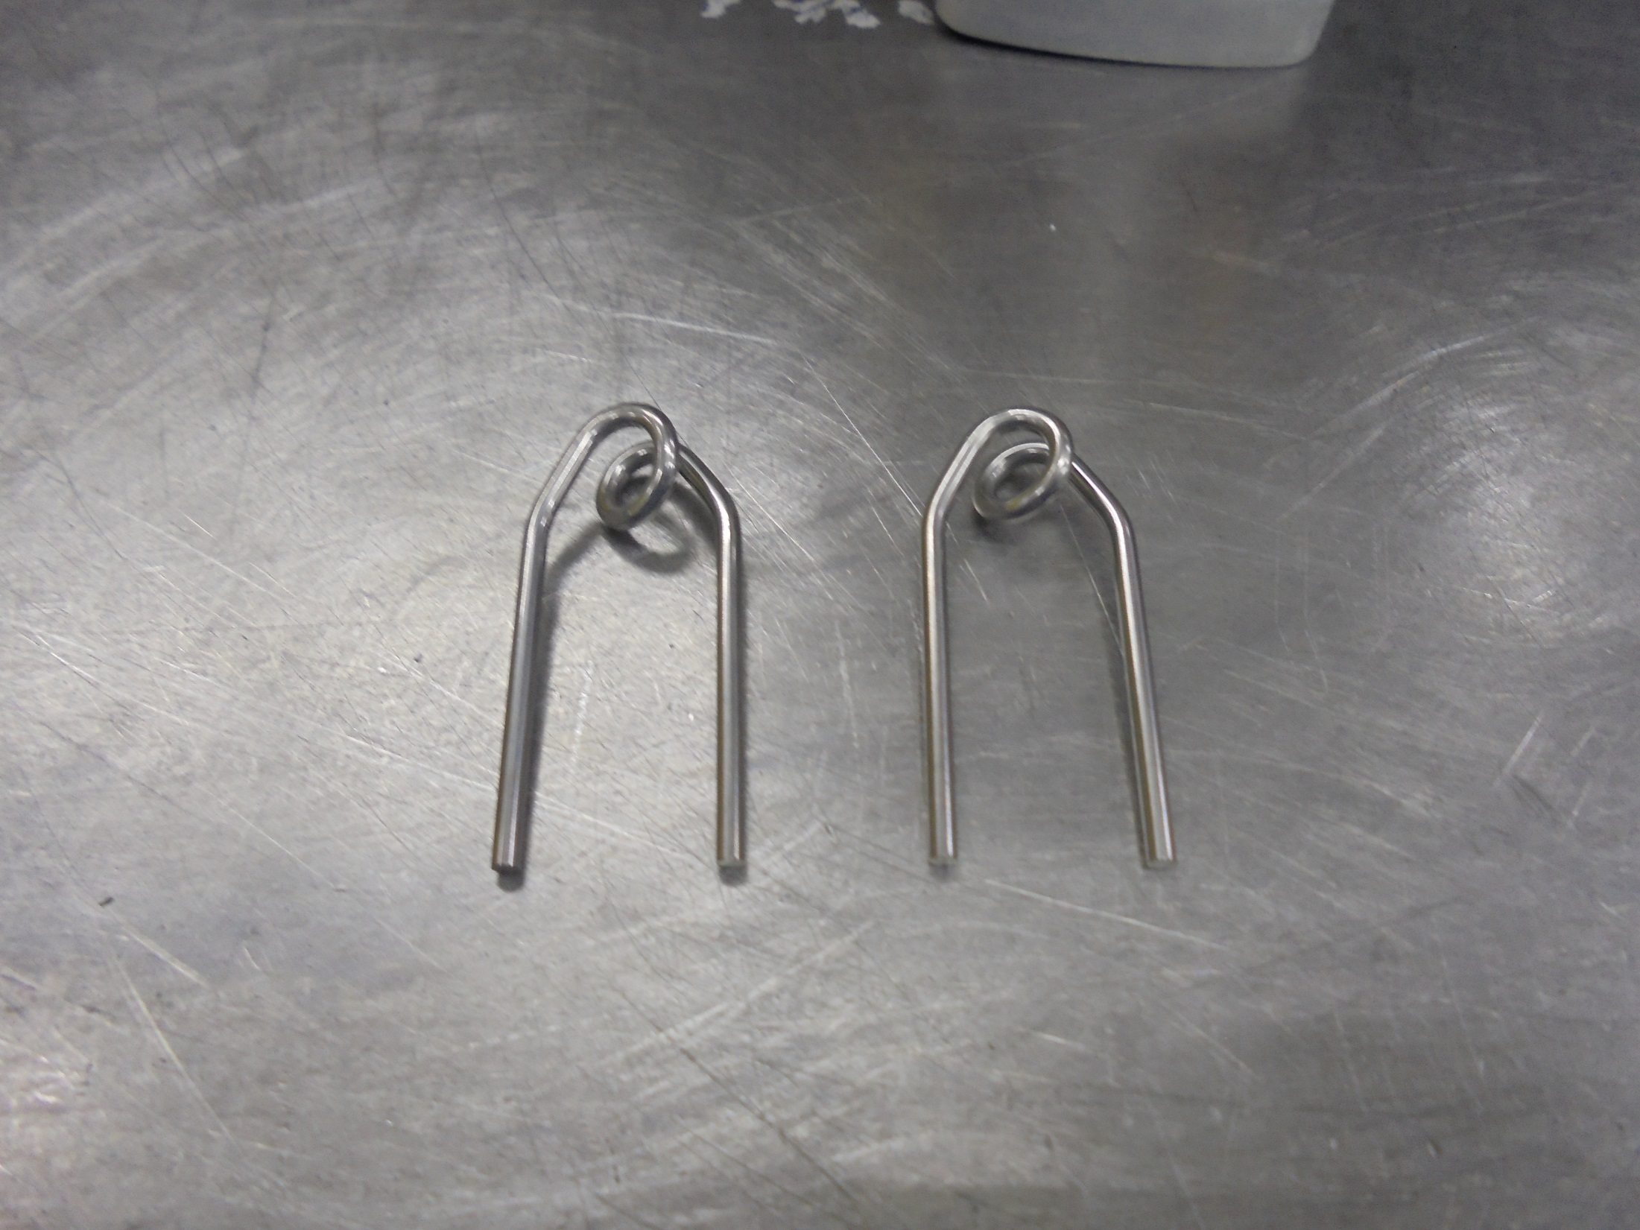
FILAMENT

Slide 5
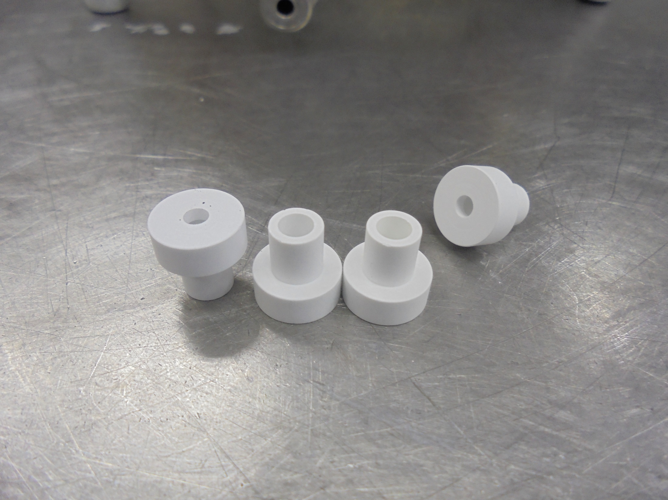
FILAMENT INSULATOR [BORON NITRIDE]

Slide 6
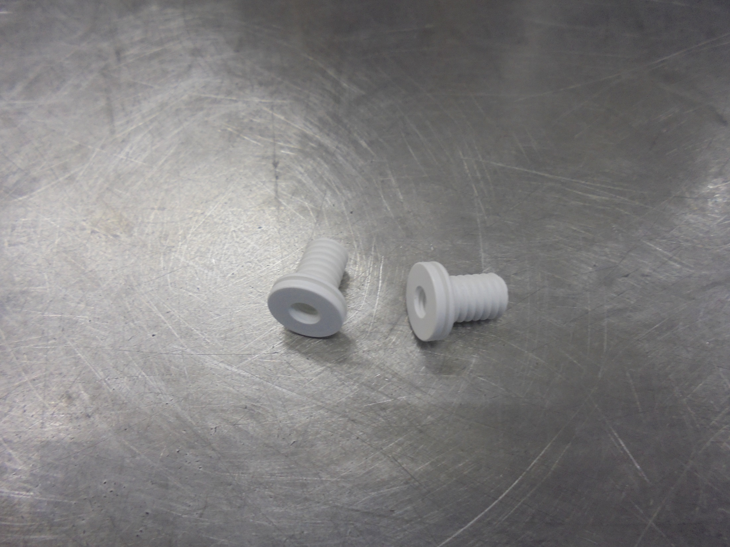
REPELLER INSULATOR

Slide 7
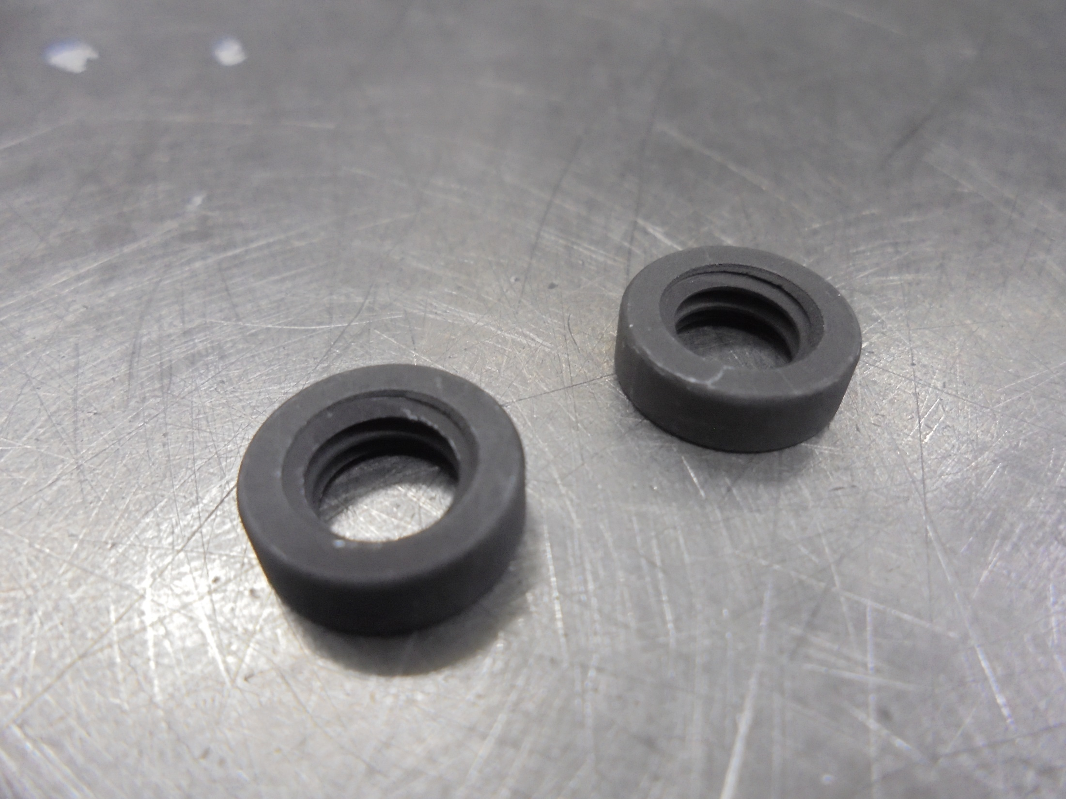
INSULATOR NUT [GRAPHITE]

Slide 8
Alignment Tools

Slide 9
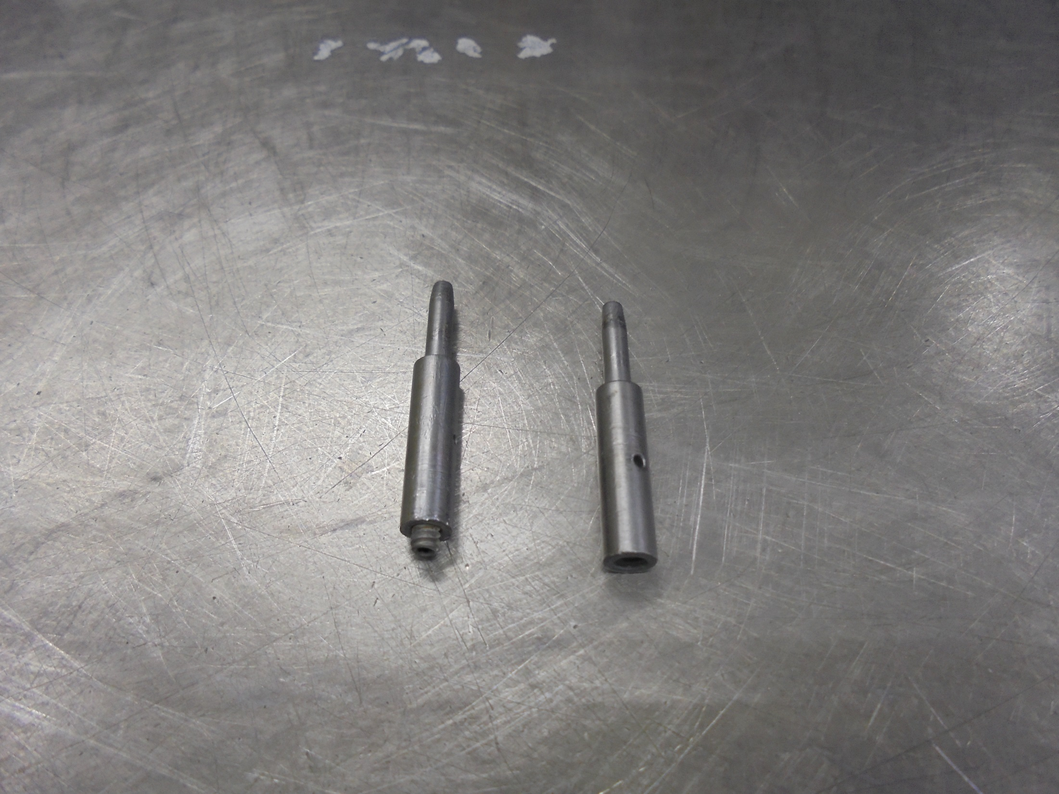
FILAMENT CLAMP PINS [OLD]

Slide 10
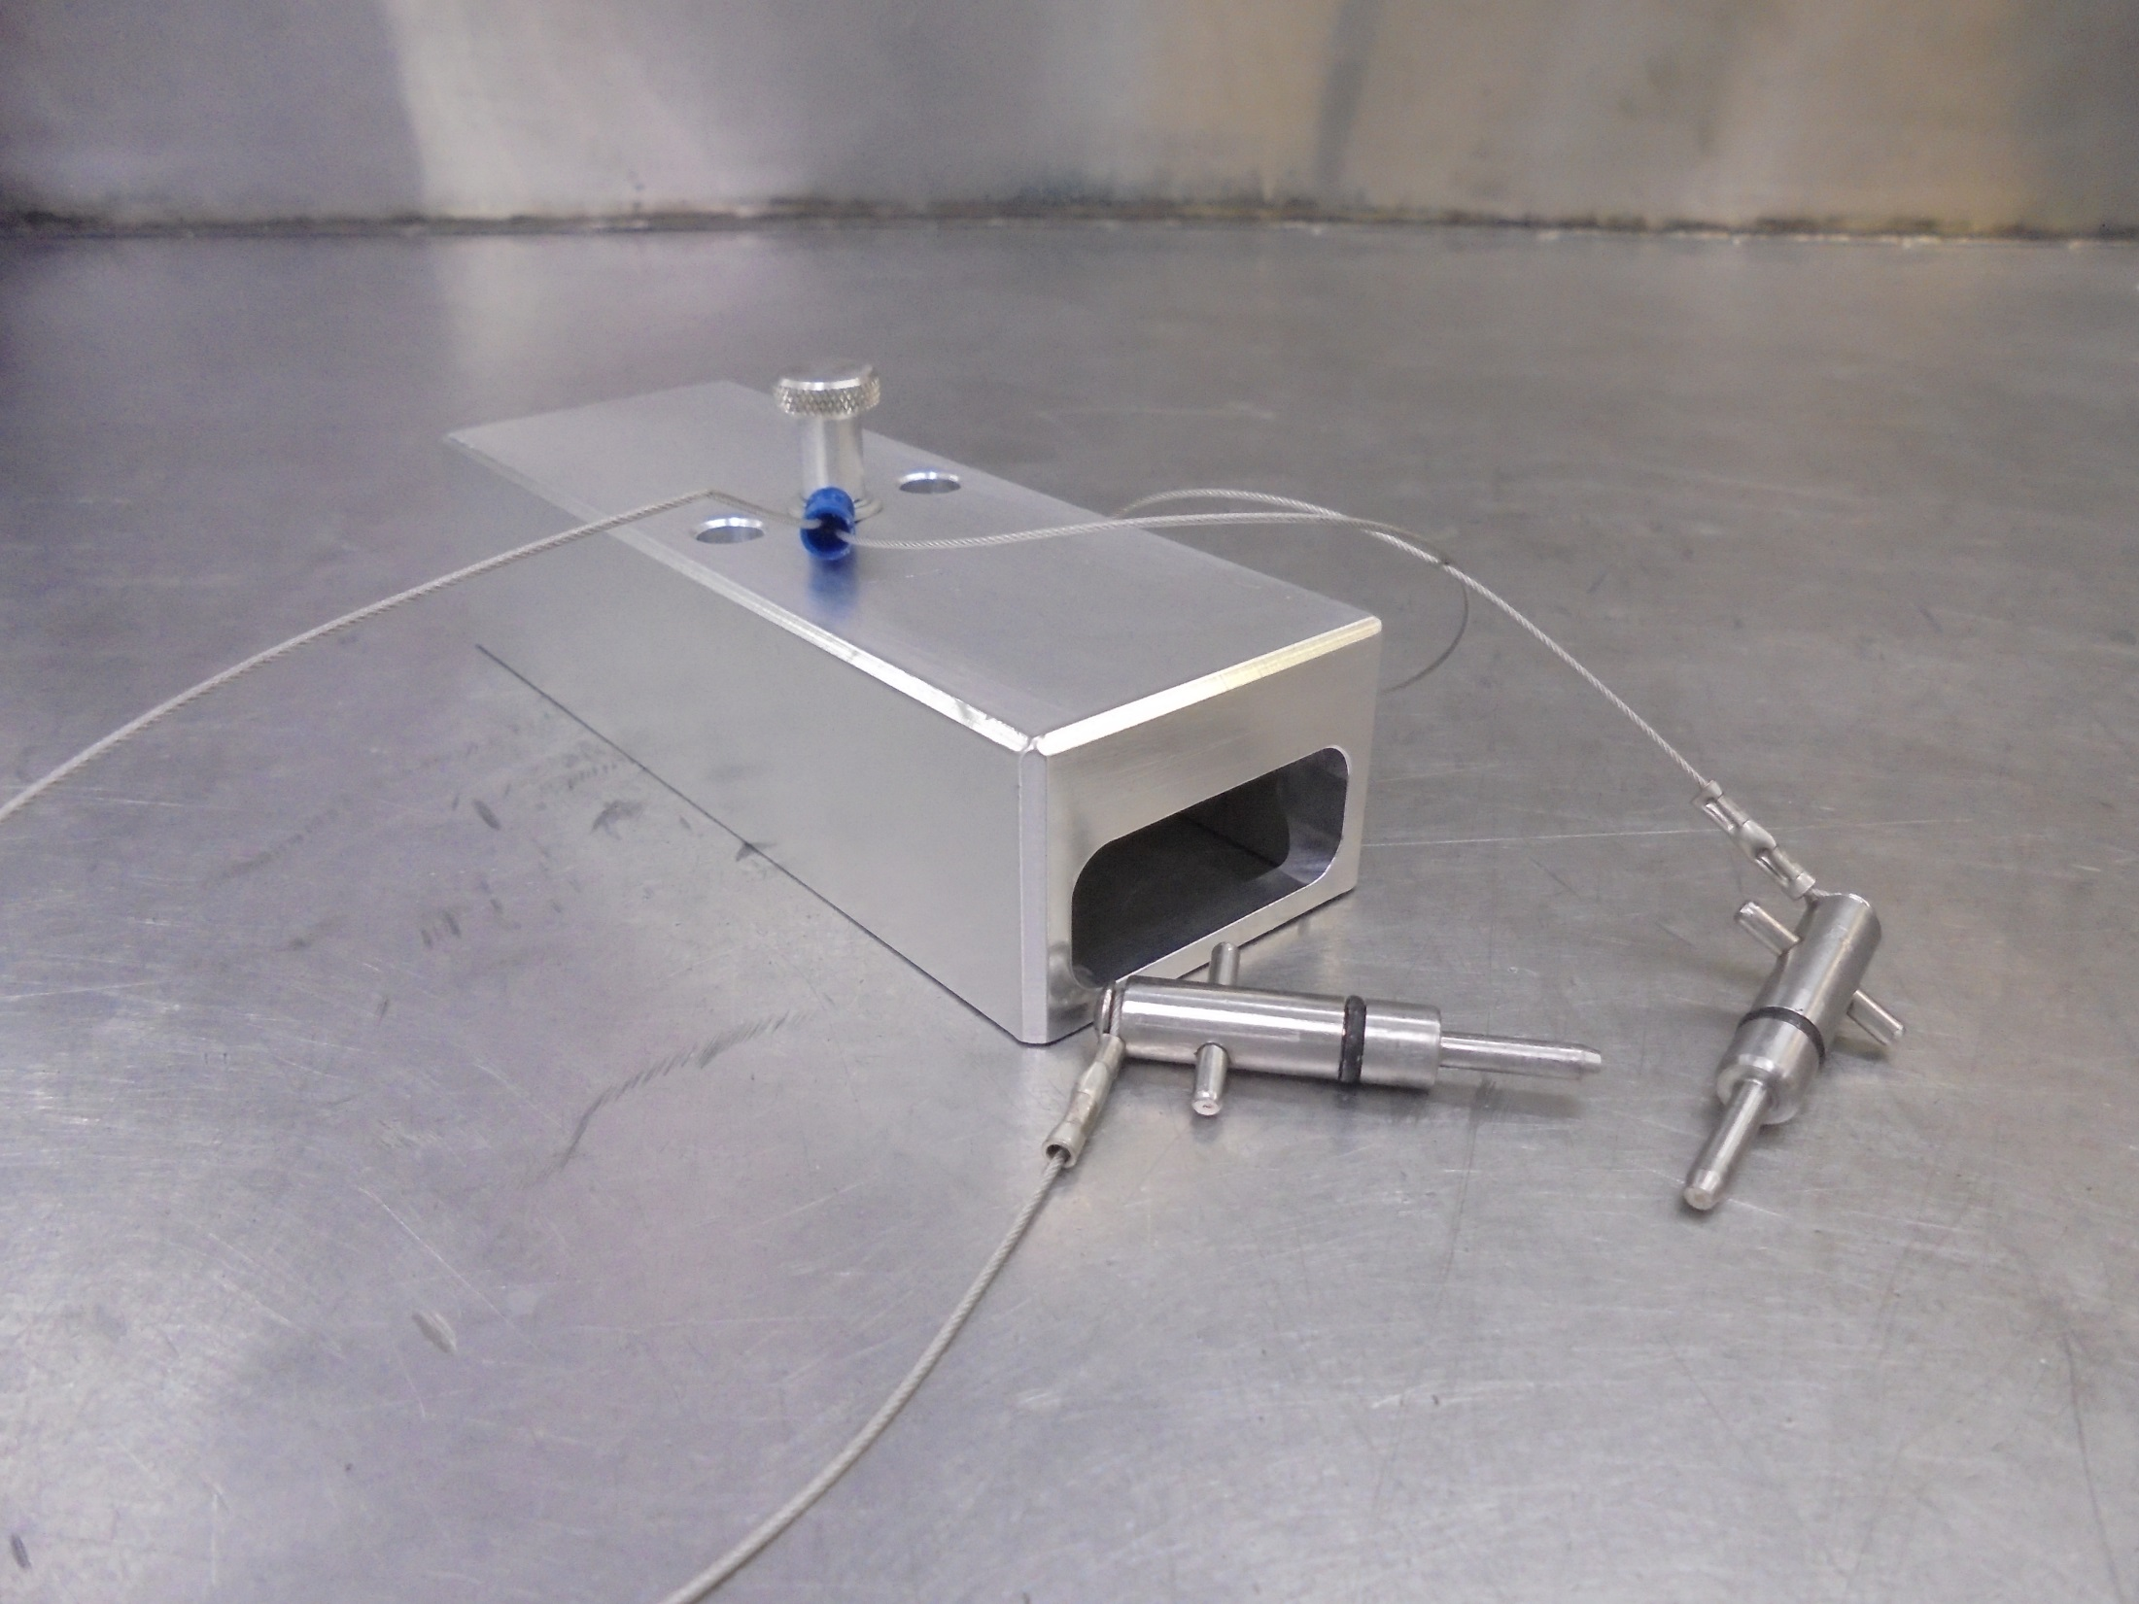
MODIFIED FILAMENT ALIGNMENT TOOL

Slide 11
Assembly

Slide 12
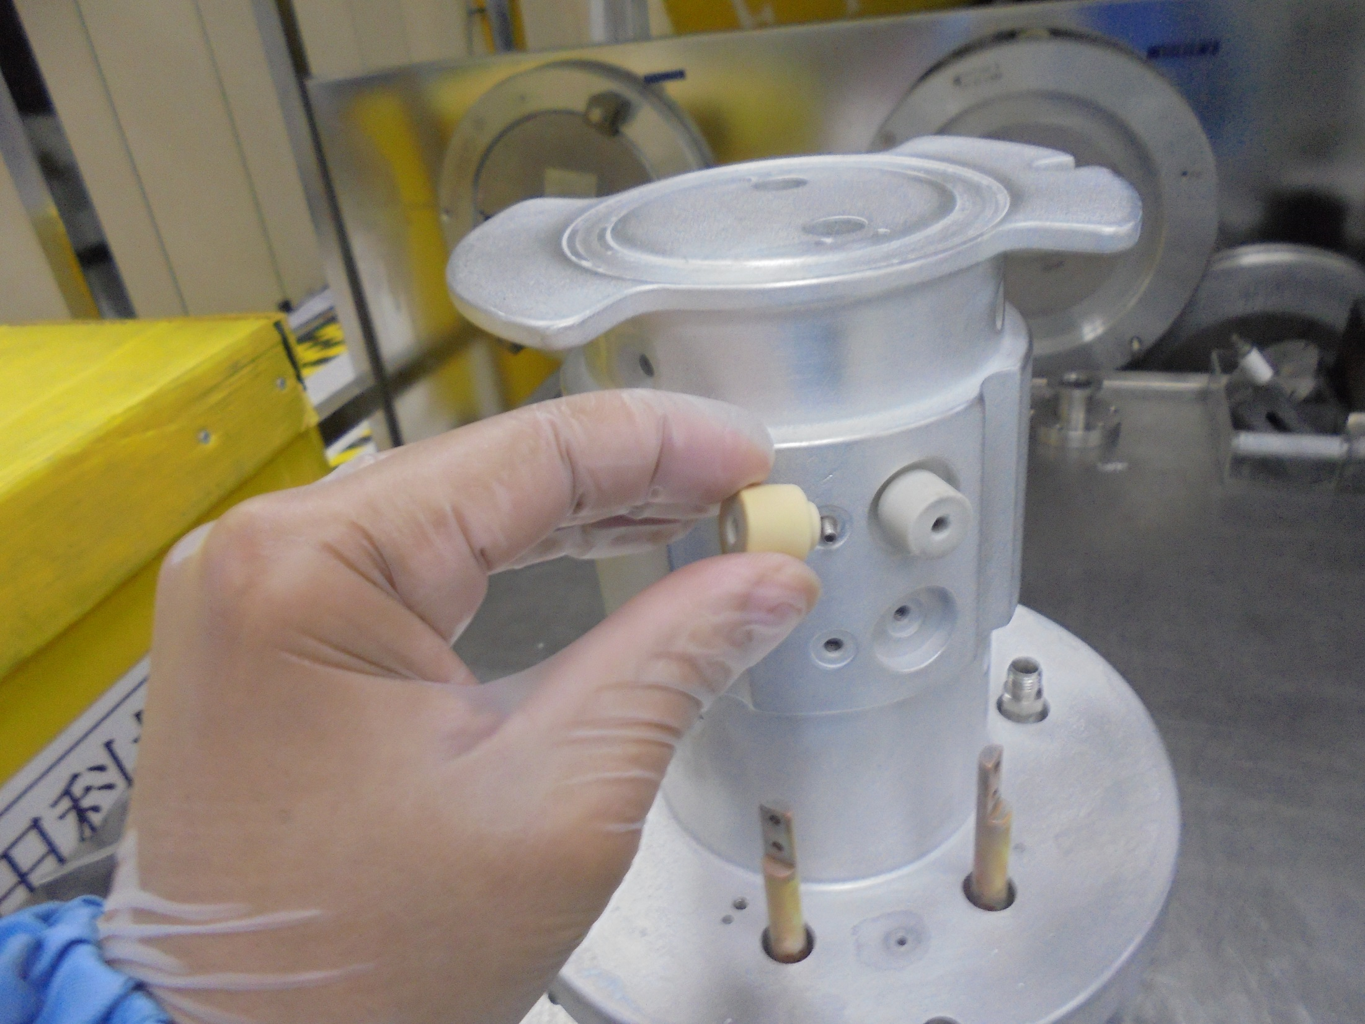
Install FILAMENT CLAMP
INSULATOR

Slide 13
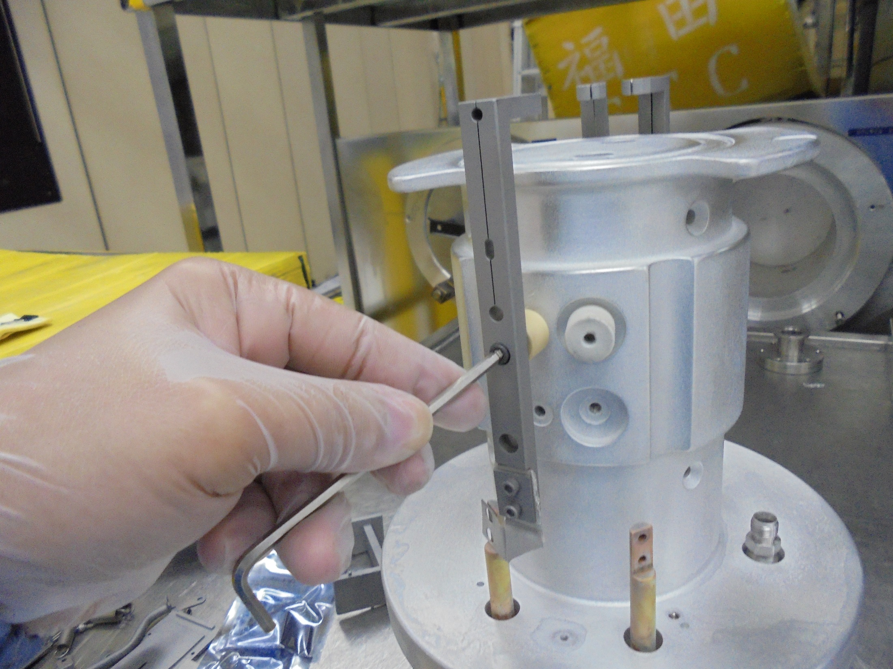
Install FILAMENT CLAMPS
[secure the screws]

Slide 14
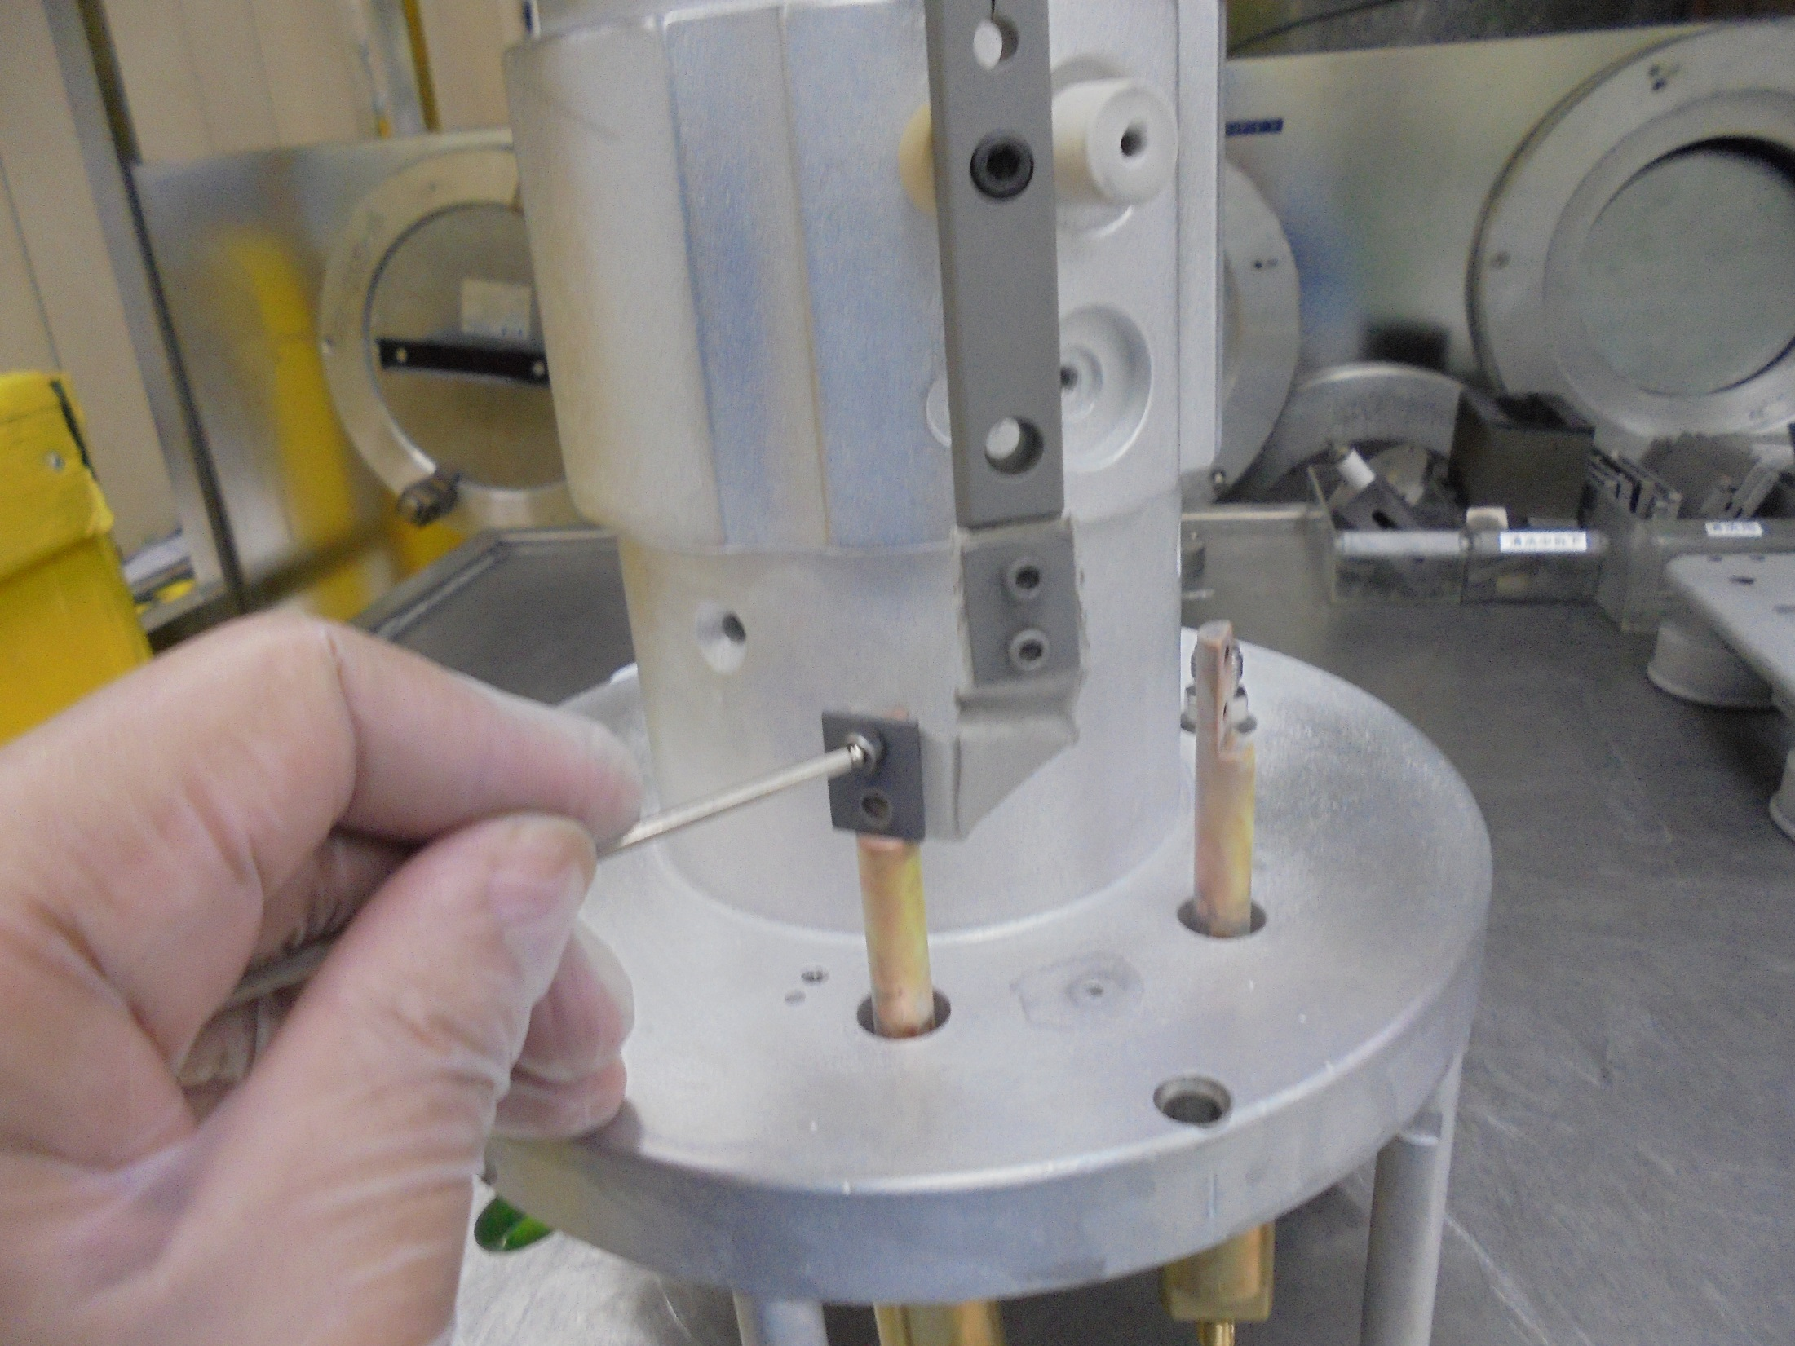
Connect FILAMENT STRAP
on FILAMENT ROD
FILAMENT
ROD
FILAMENT
STRAP

Slide 15
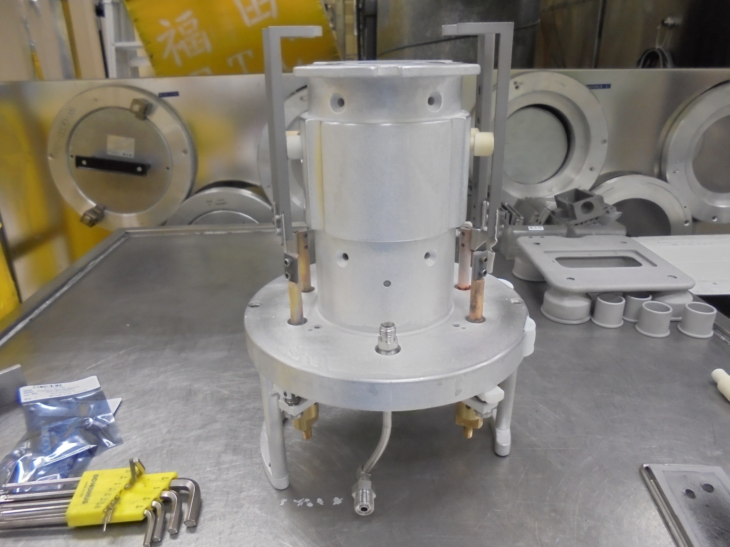
*4 FILAMENT CLAMP ALREADY INSTALL

Slide 16
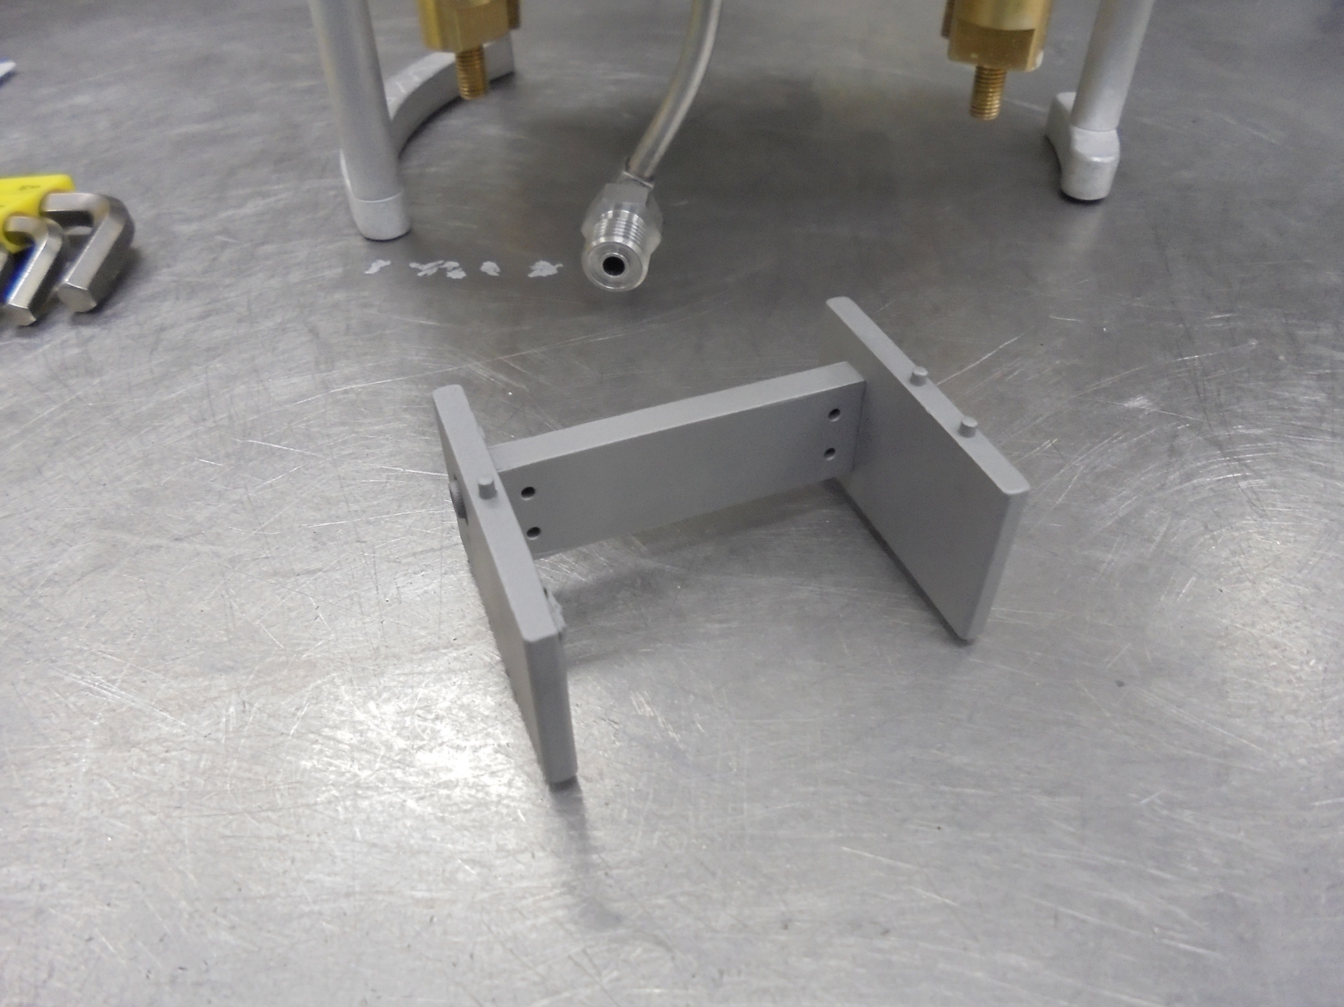
ARC CHAMBER BASE SUPPORT
BOTTOM STAGE
MOUNTING STAGES [SIDE]

Slide 17
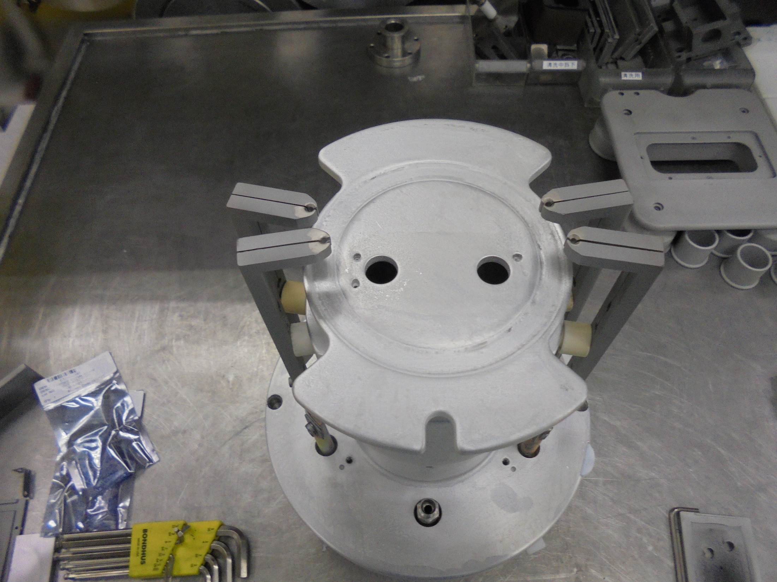
TOP FACE OF SOURCE BODY
Locator Slot For
MOUNTING STAGE

Slide 18
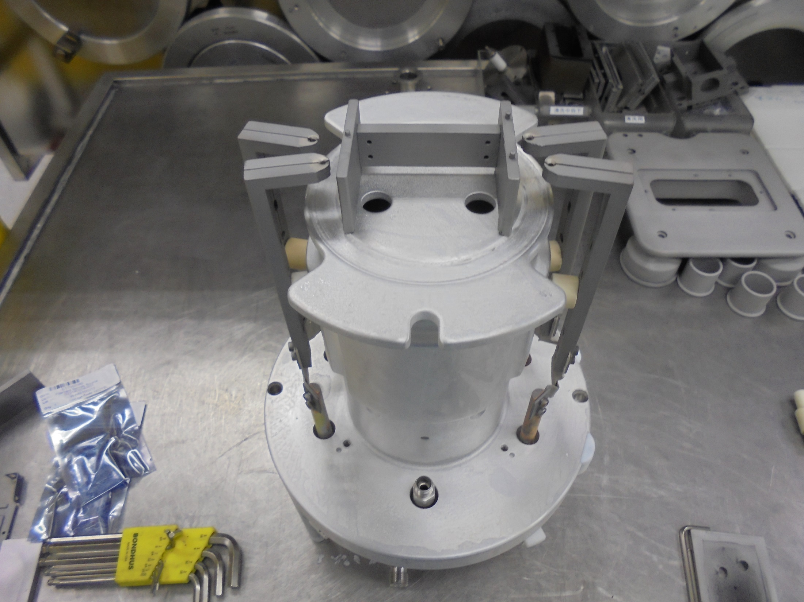
Install The MOUNTING STAGE

Slide 19
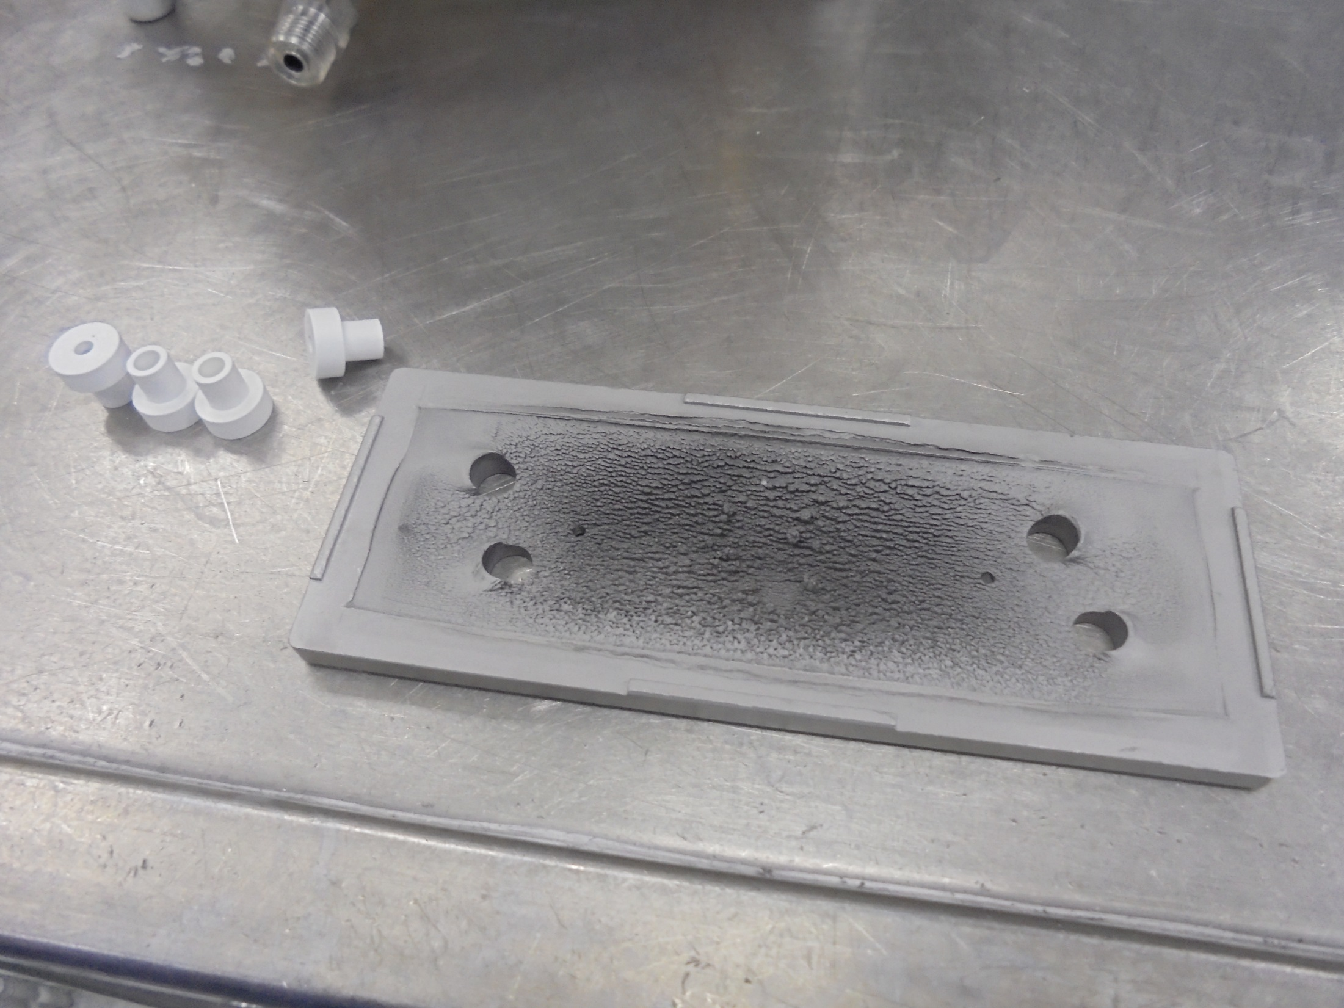
FILAMENT INSULATOR
ARC CHAMBER BASE PLATE

Slide 20
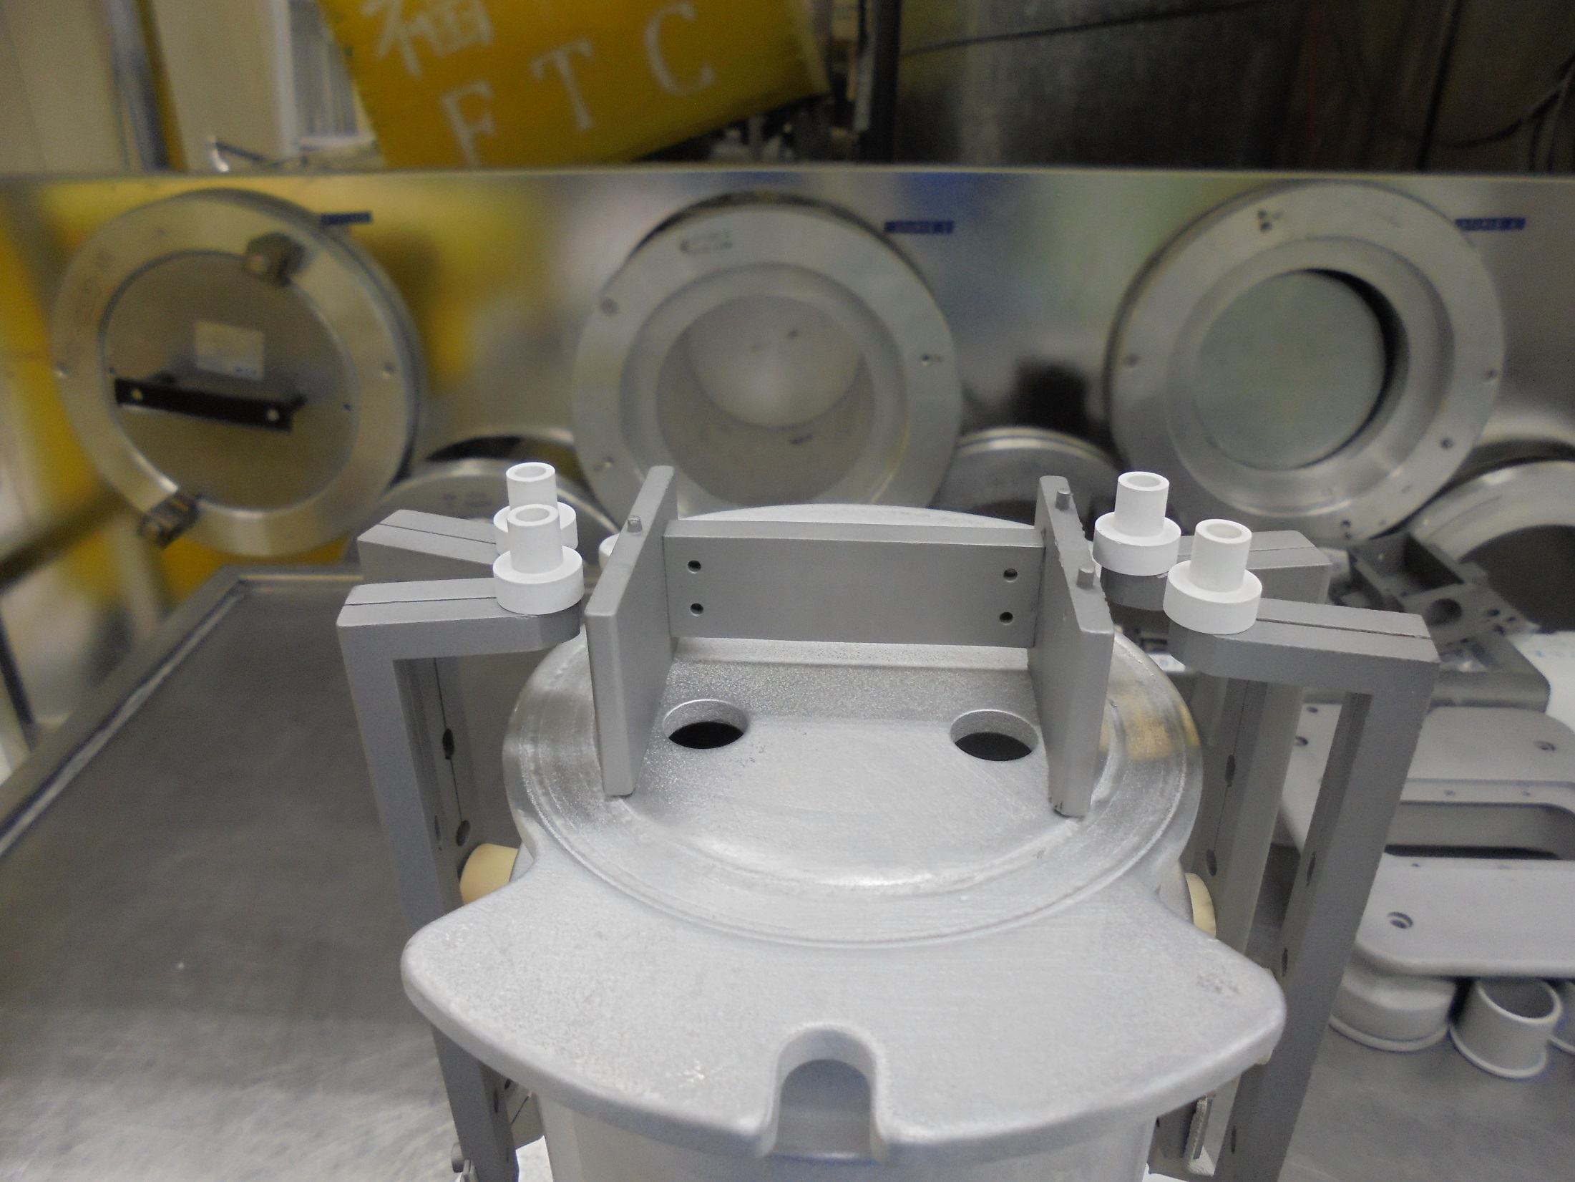
*FILAMENT INSULATOR On Top Of
FILAMENT CLAMP

Slide 21
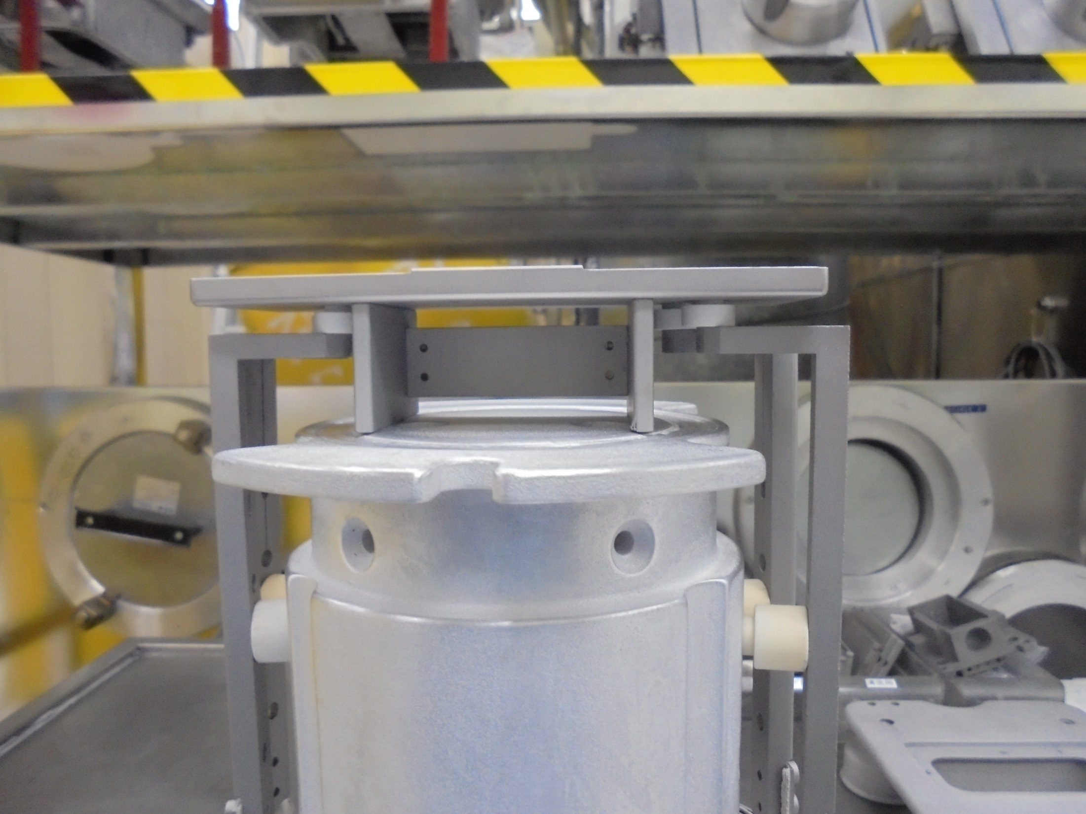
Install the ARC BASE PLATE

Slide 22
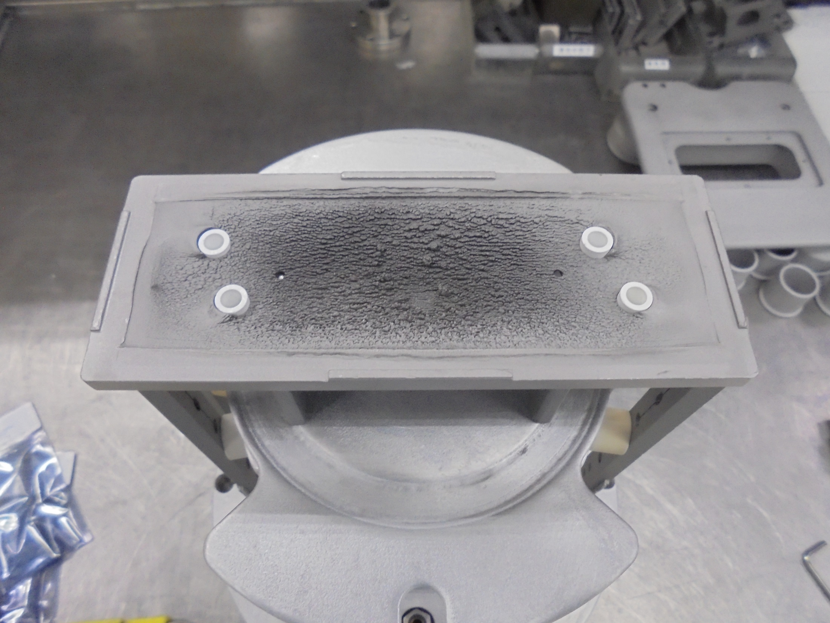
TOP VIEW
FILAMENT INSULATOR

Slide 23
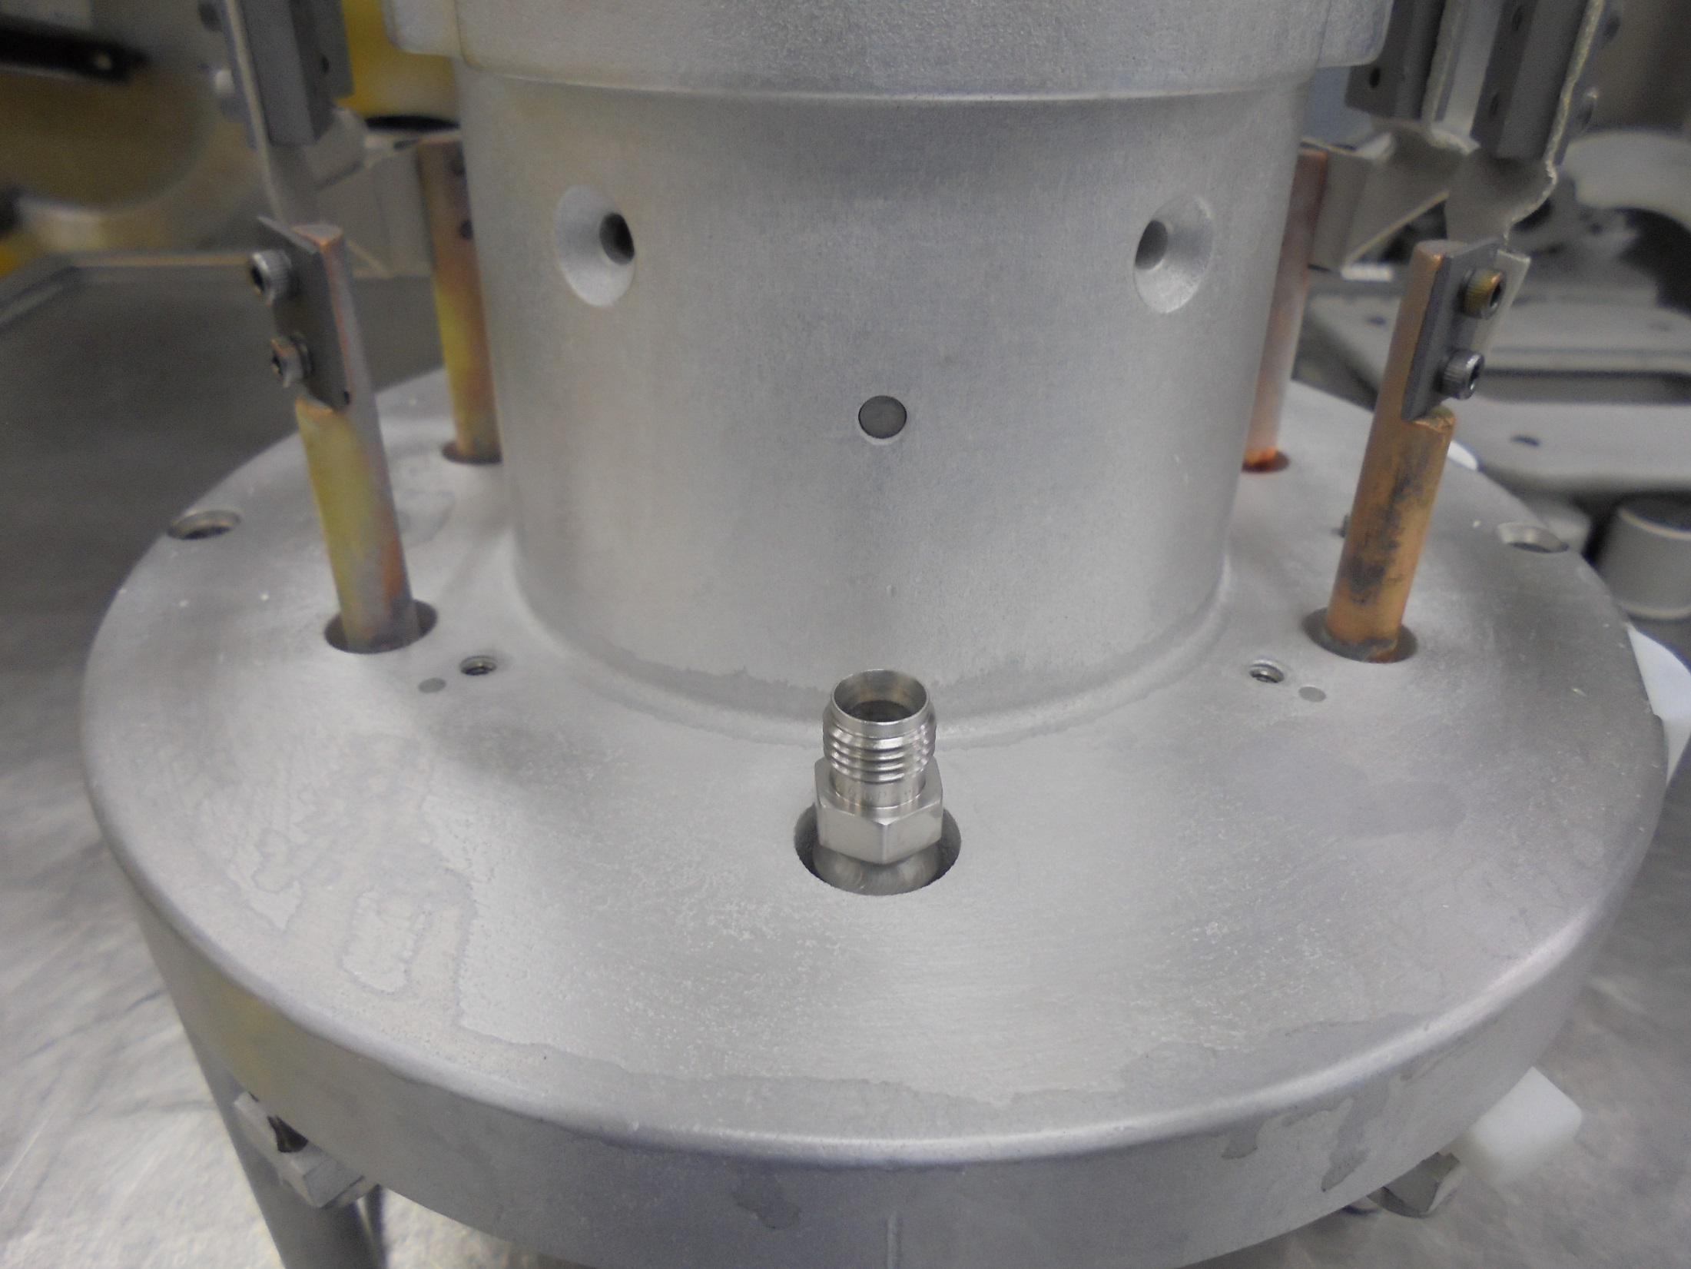
GAS FEED-THRU

Slide 24
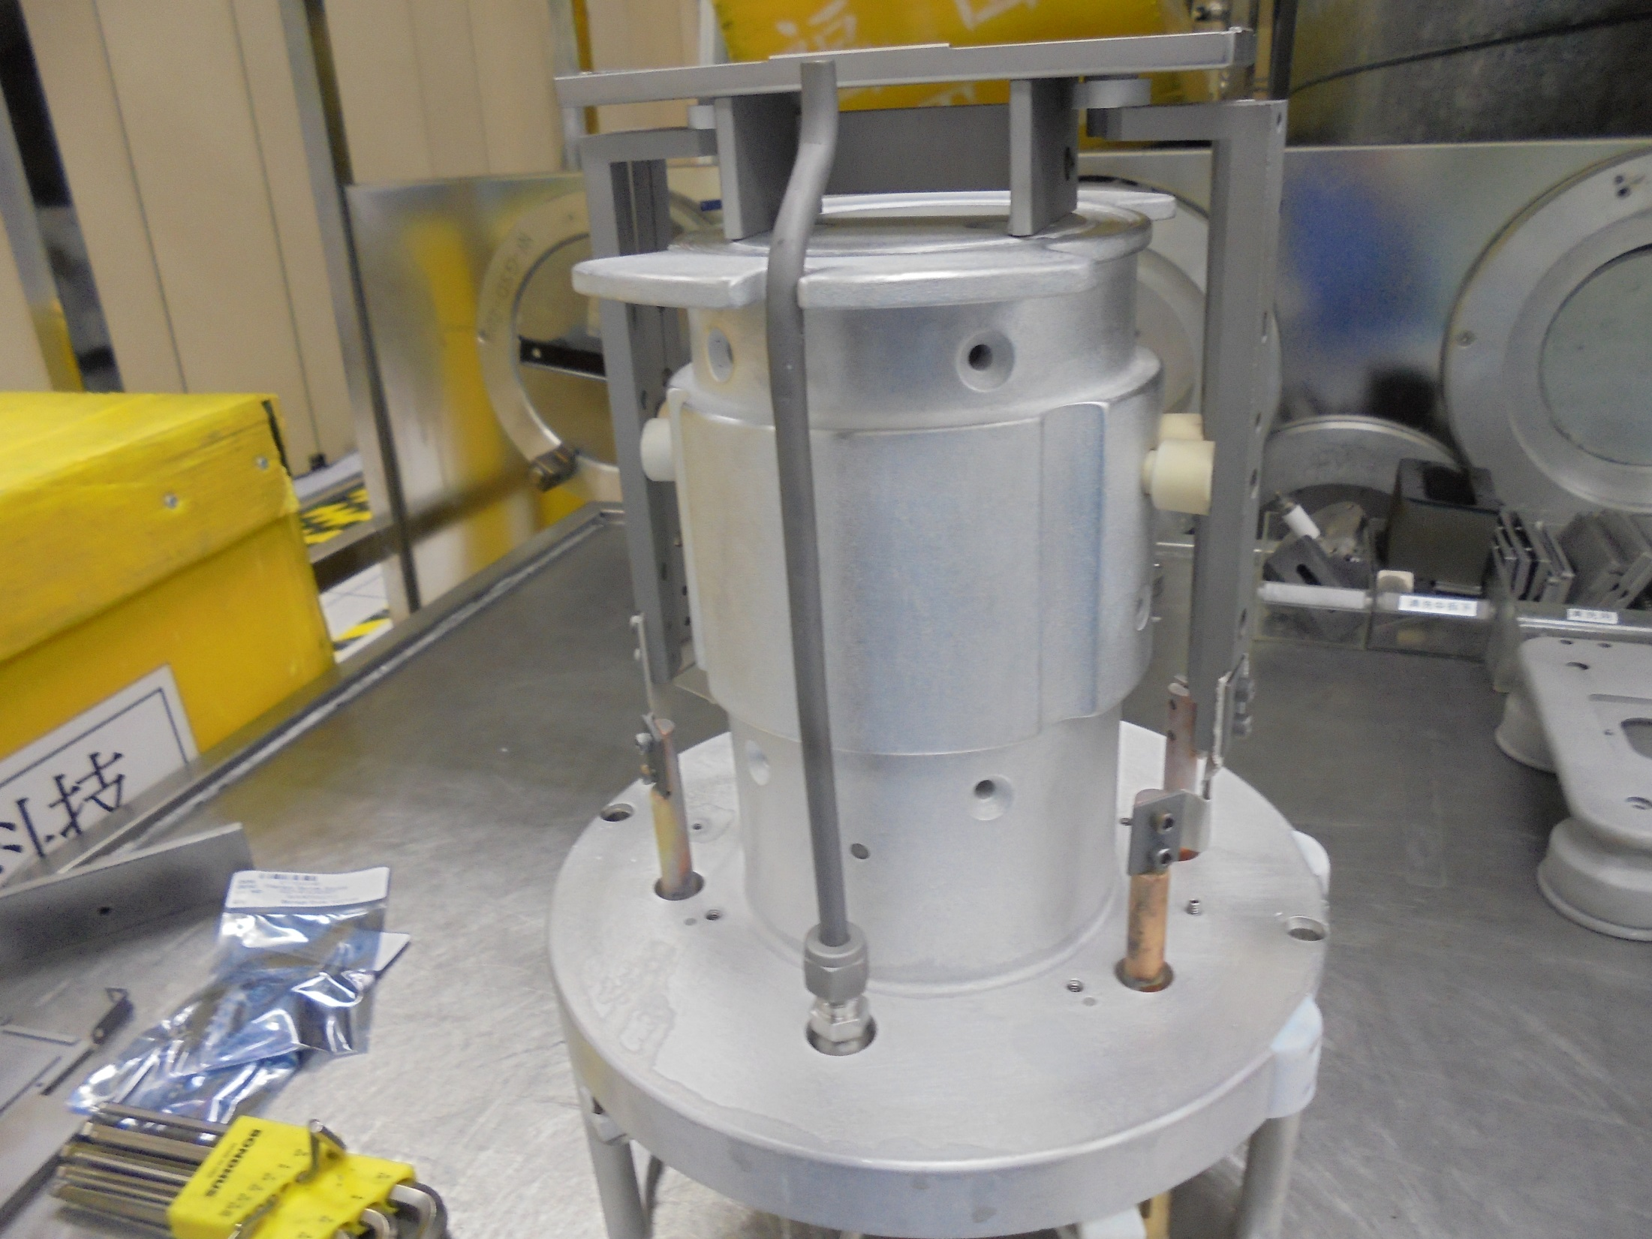
Install The
GAS TUBE

Slide 25
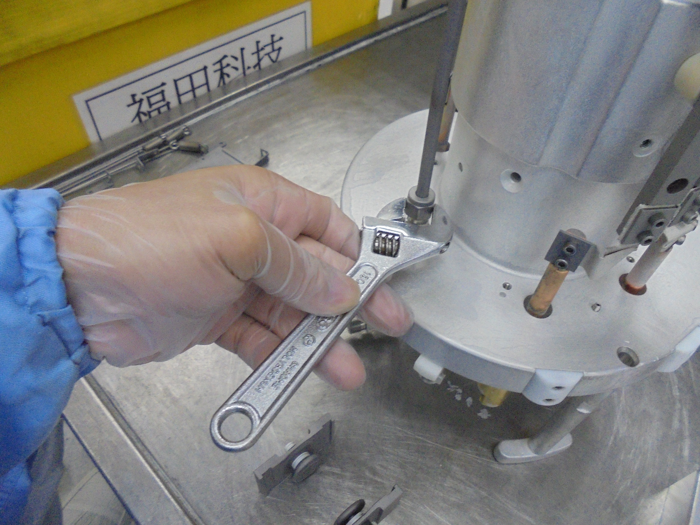
Secure Tighten

Slide 26
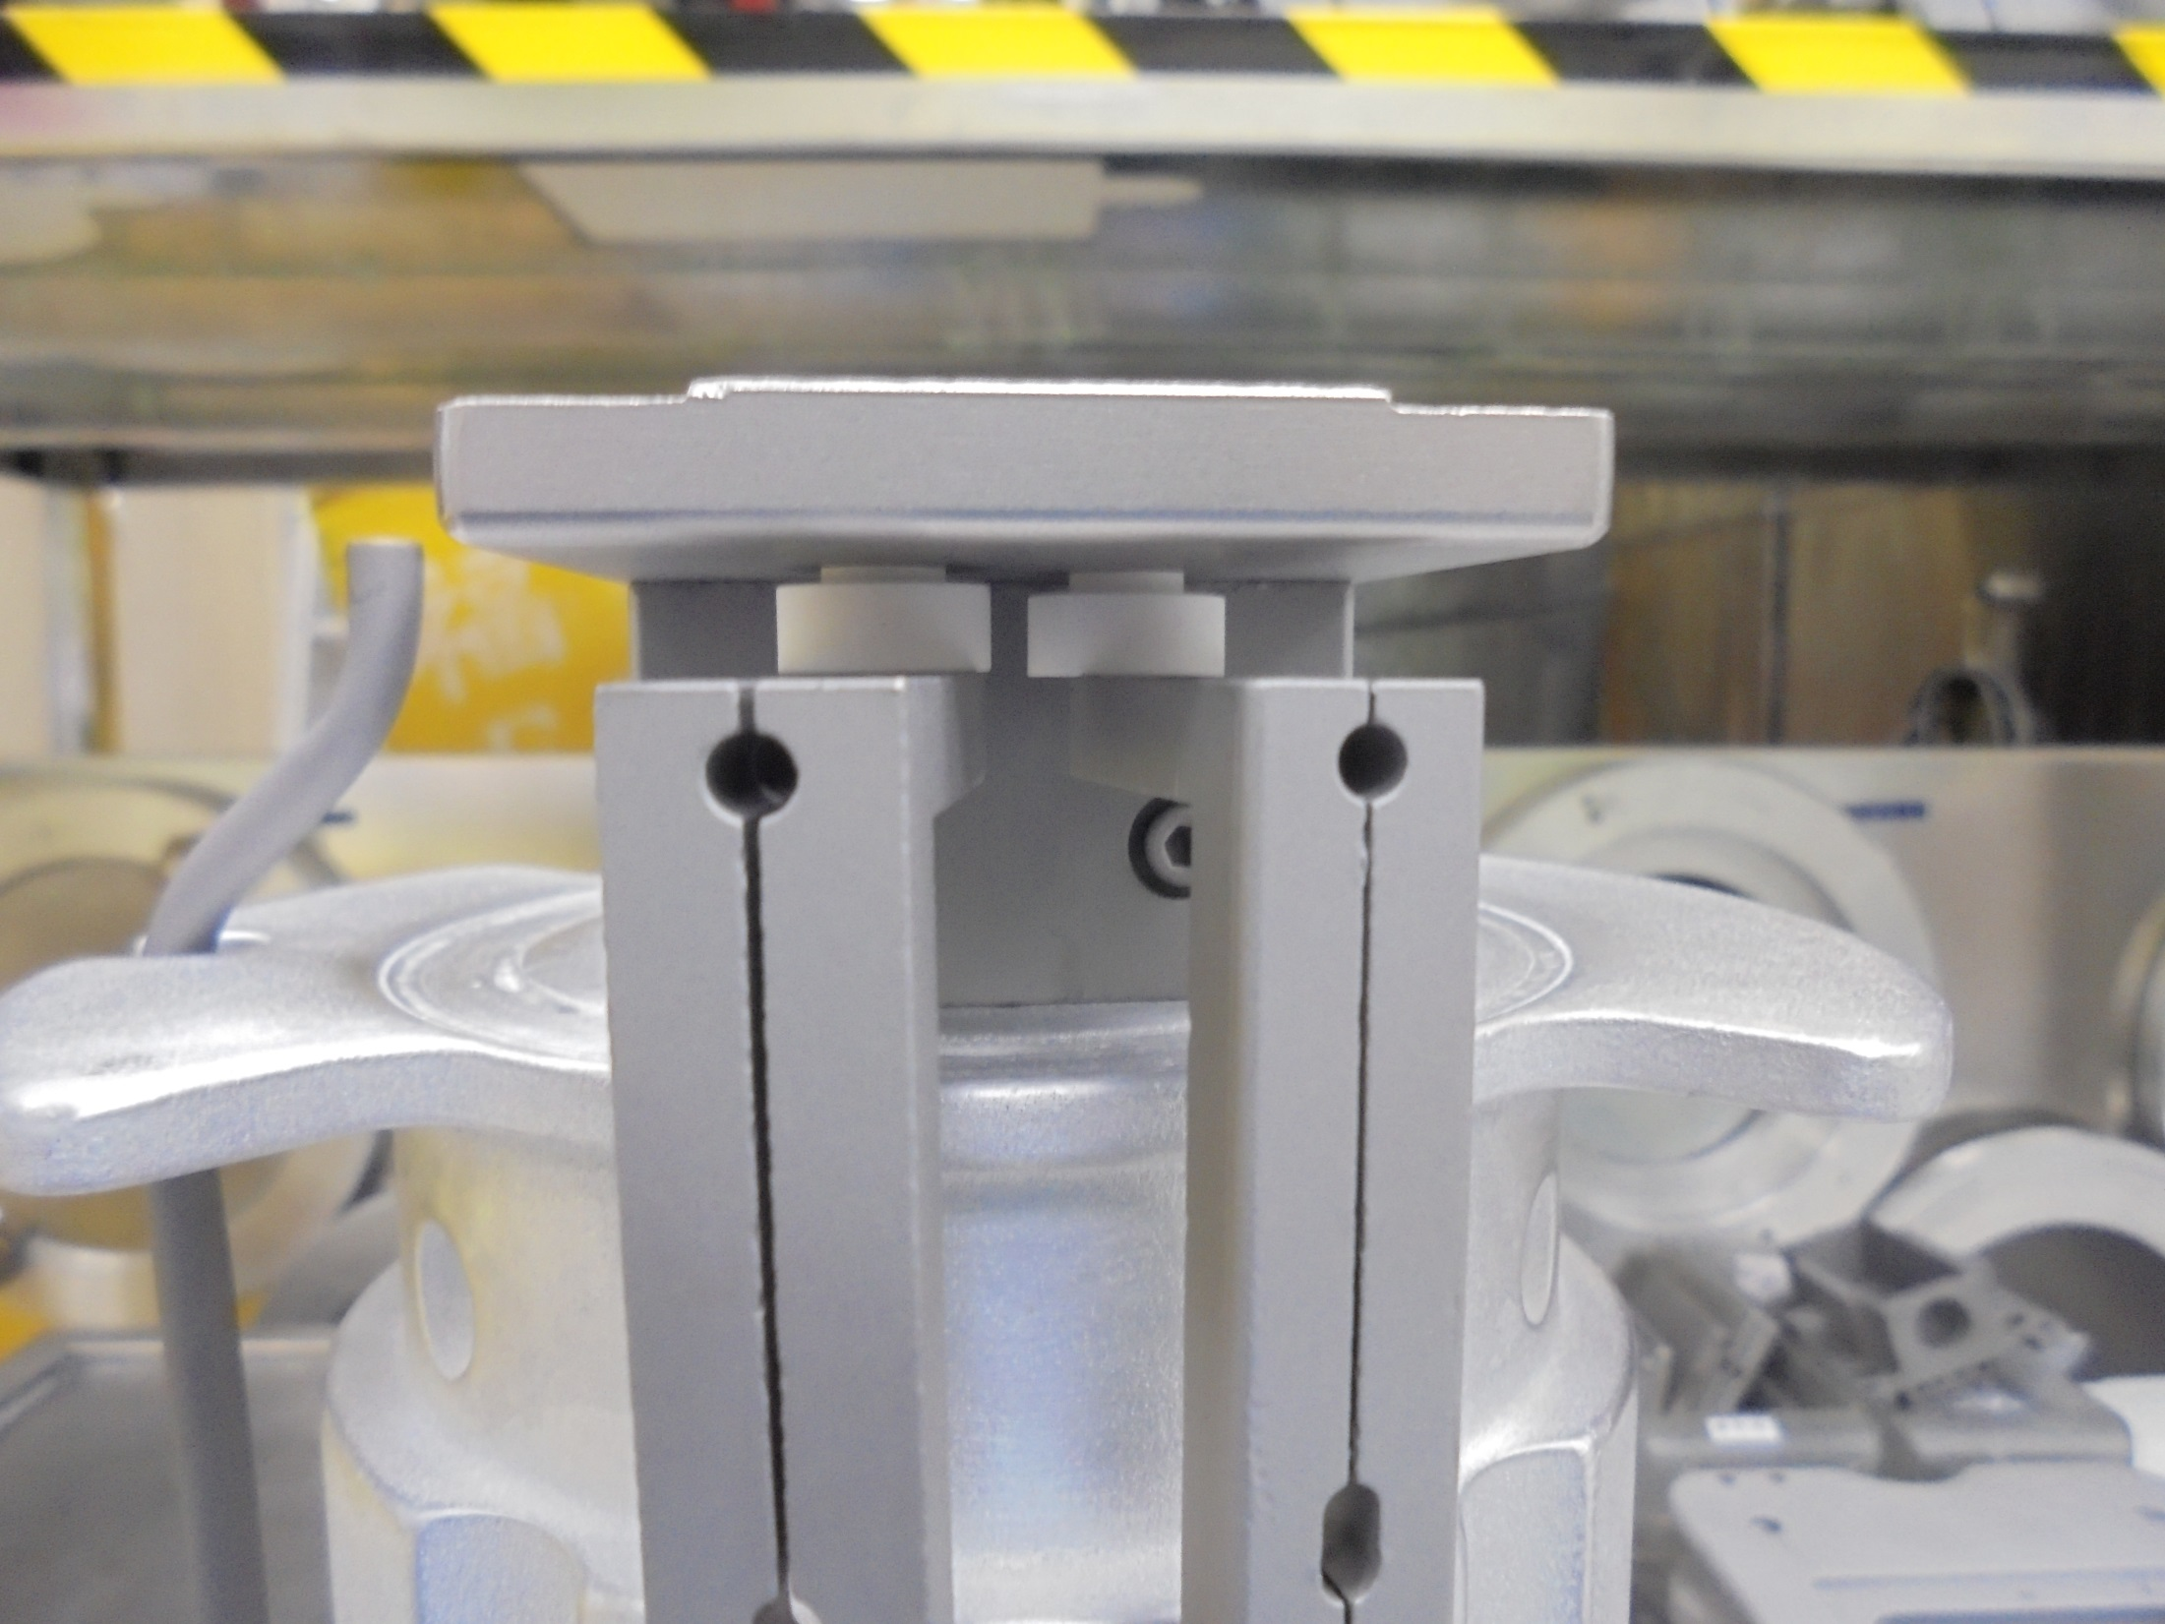
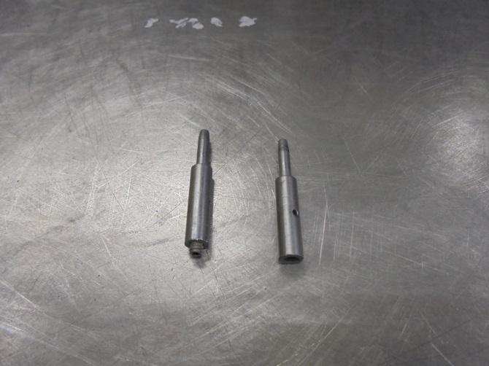
Insert This…
HERE!!!

Slide 27
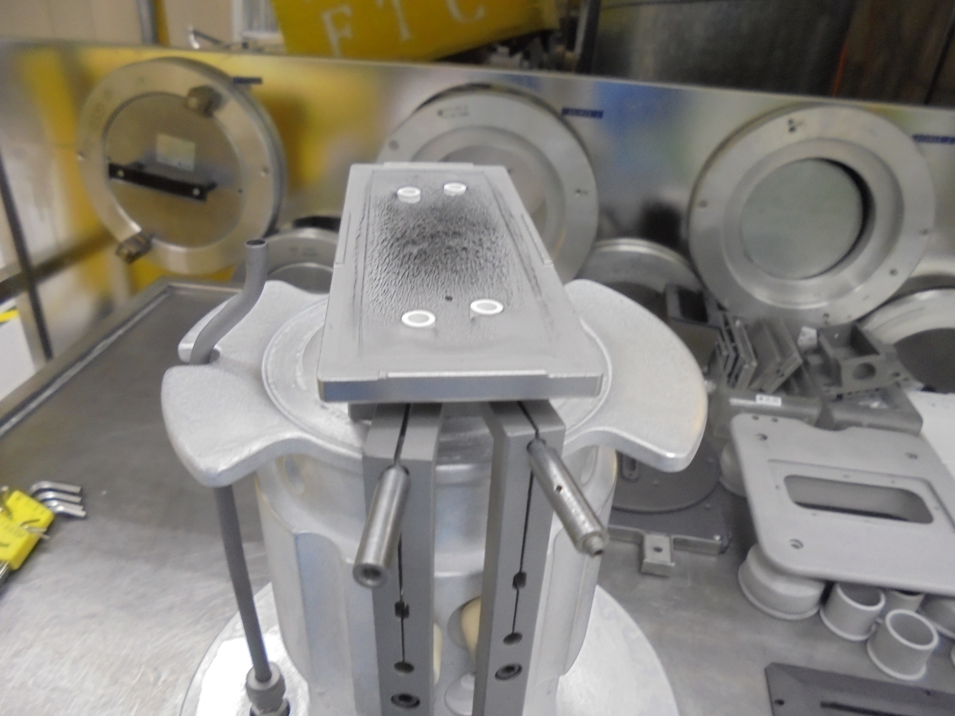
*Pins Inserted On The
FILAMENT CLAMP

Slide 28
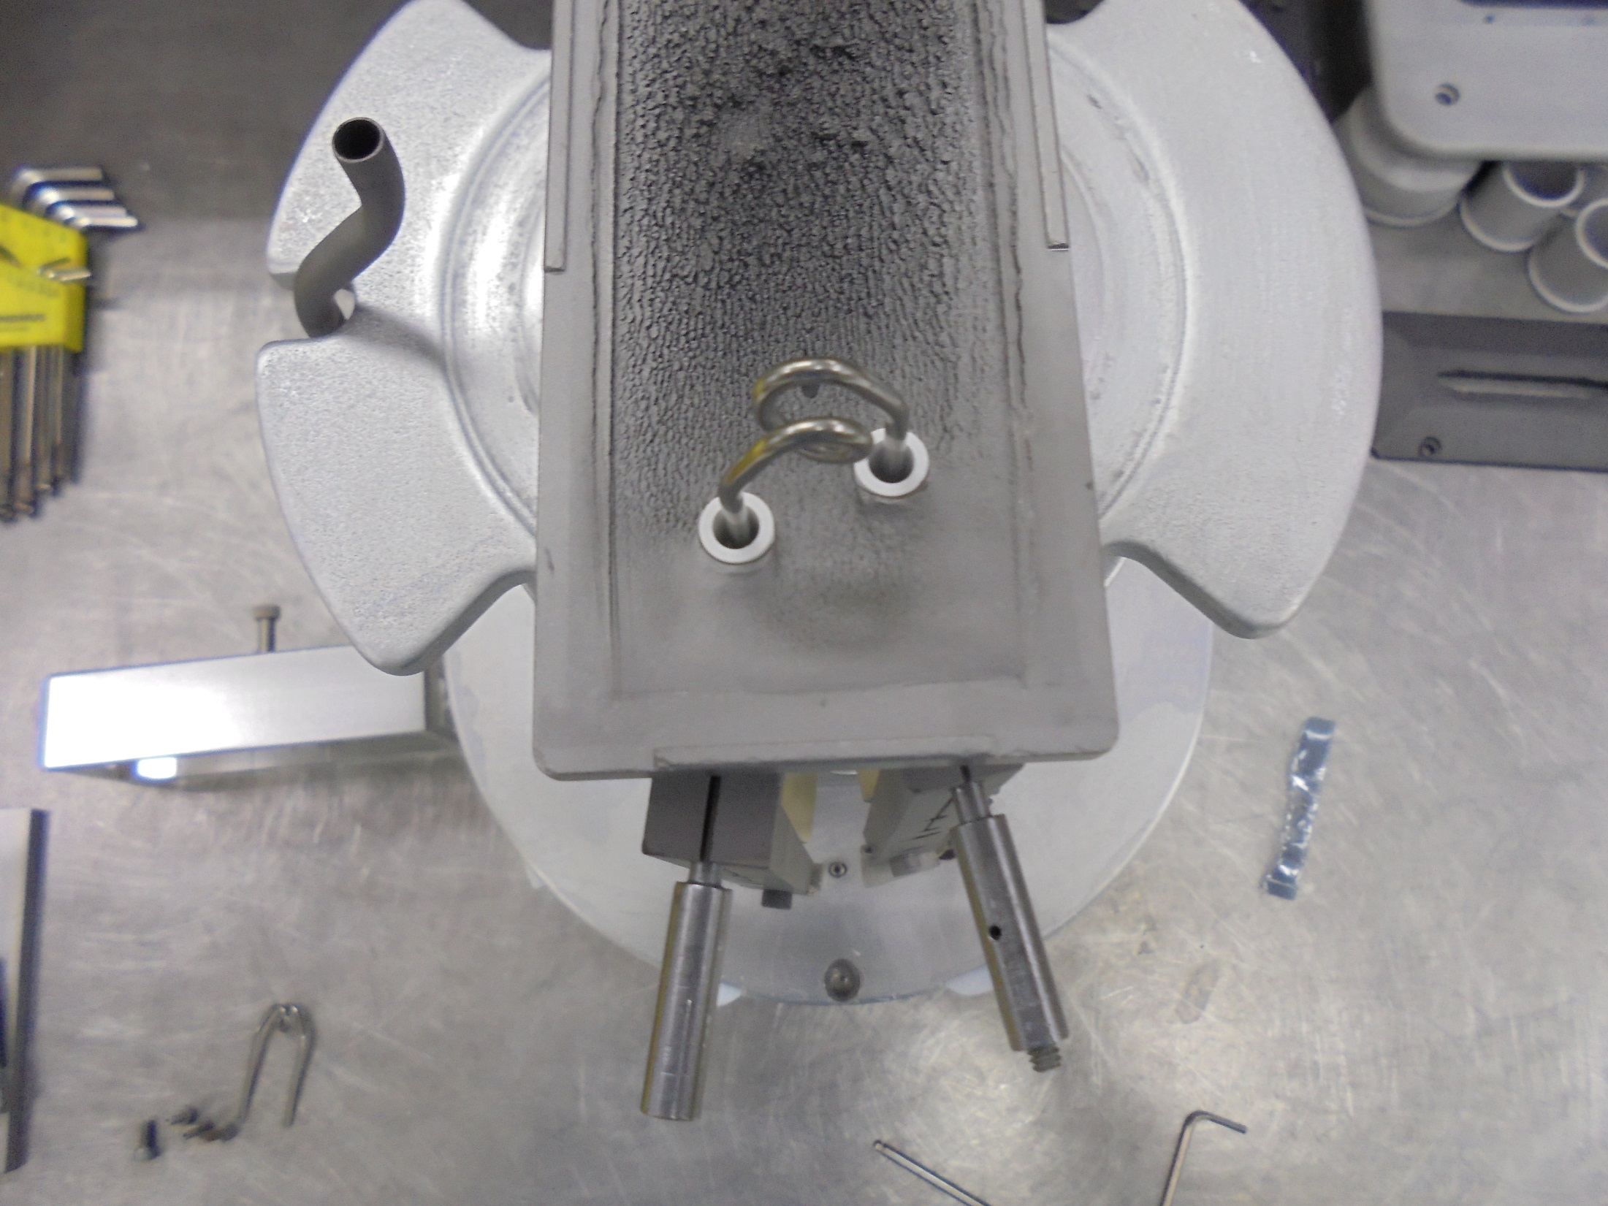
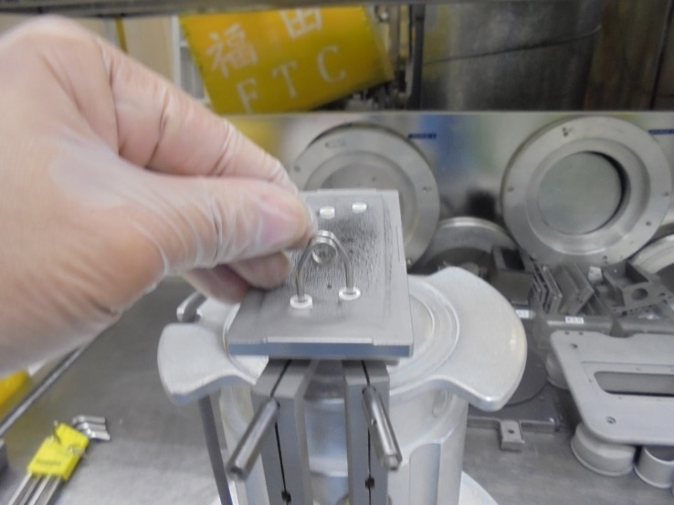
Insert The FILAMENT
Note: FILAMENT MUST BE EVENLY ALIGN Make Sure It Don’t Touch The Insulator Wall.

Slide 29
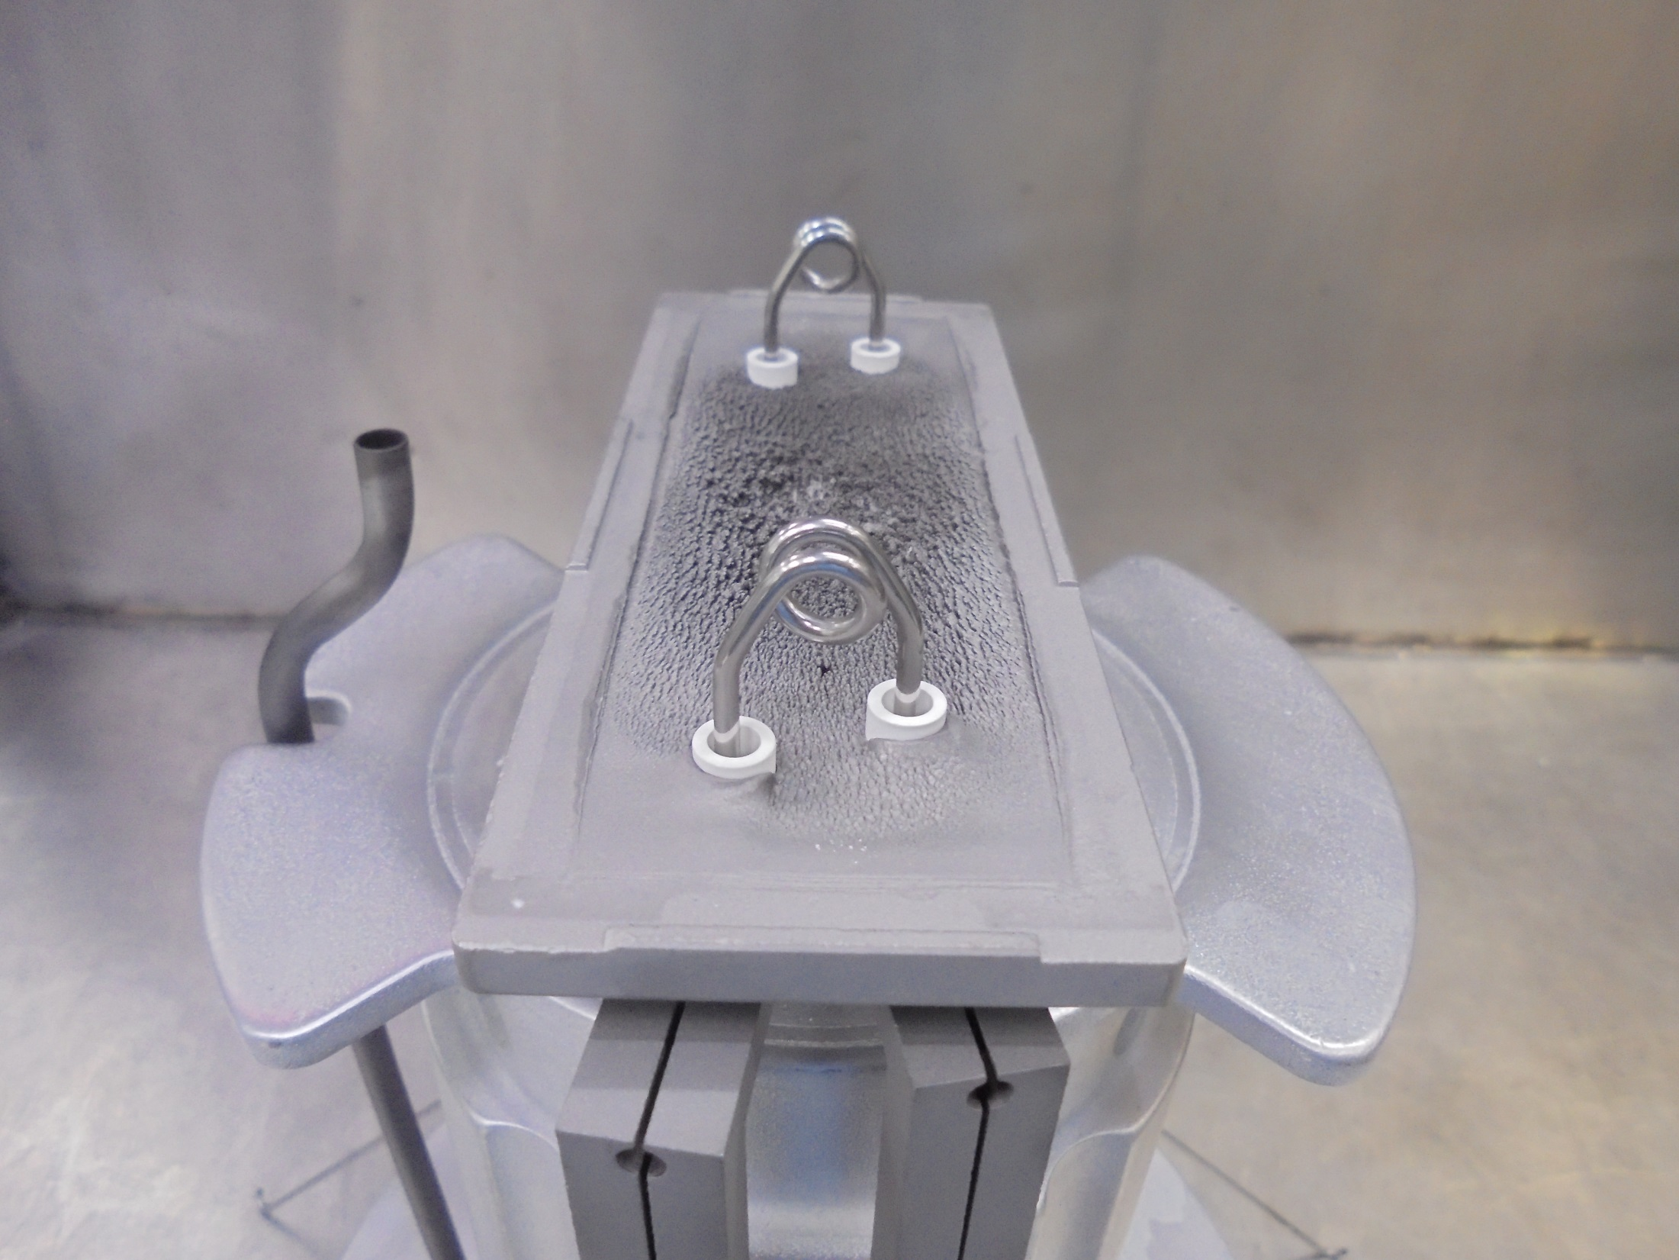
*VIIsion 200 SOURCE HEAD
Have 2 Filaments.

Slide 30
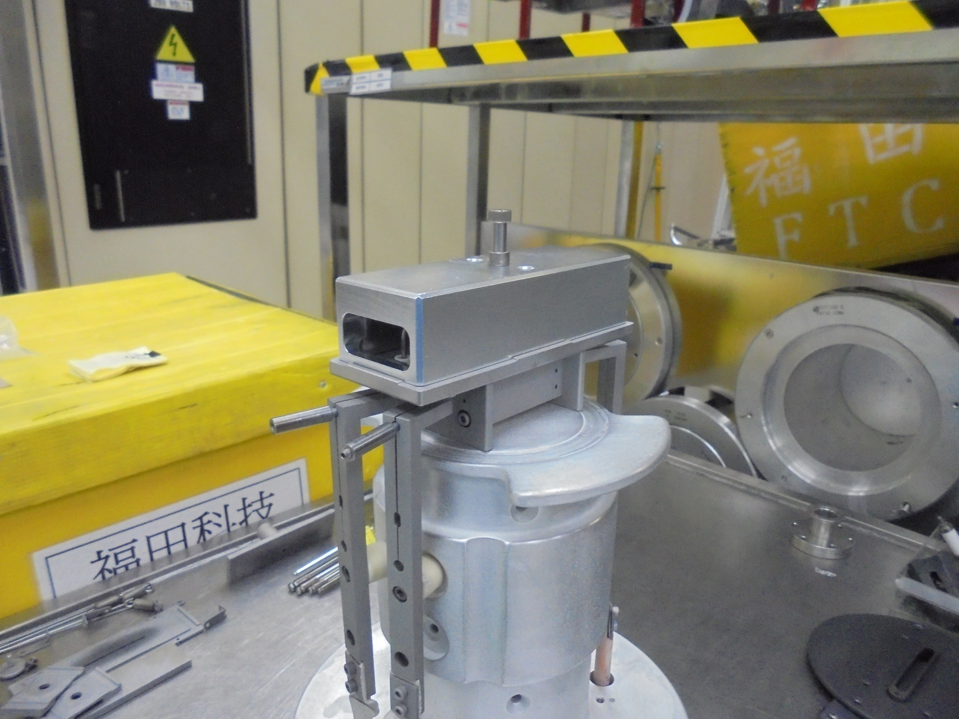
*Conduct Alignment On FILAMENT
Install The Alignment Tool

Slide 31
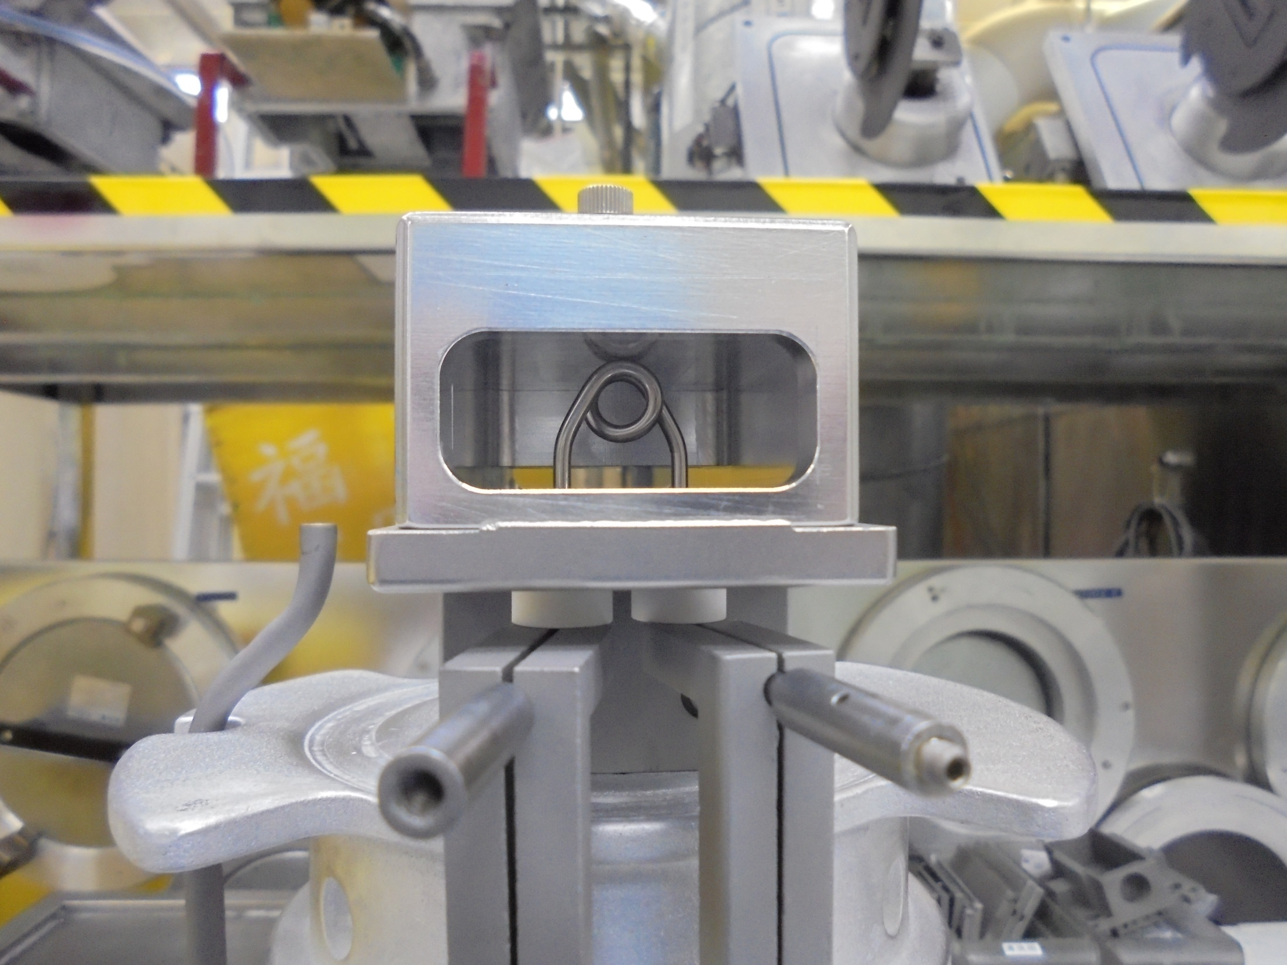
*On The Specs Height Of Filament Touching
The Upper Wall Of The Alignment Tool.

Slide 32
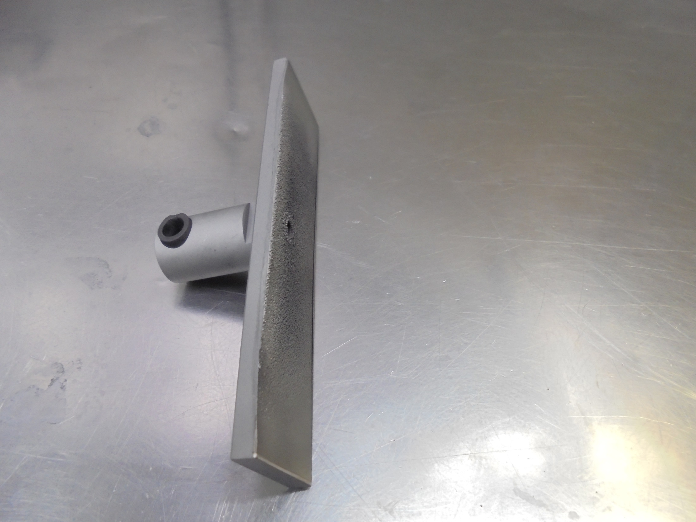
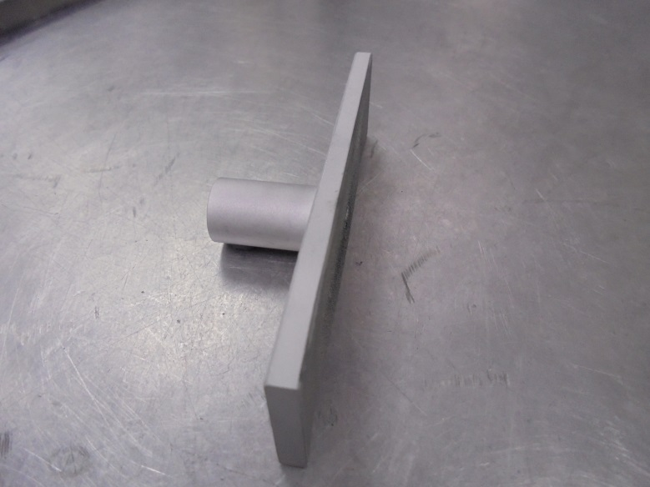
SIDE PLATE
Gas Port Tungsten
Gas Port Tube Casing
[GRAPHITE]

Slide 33
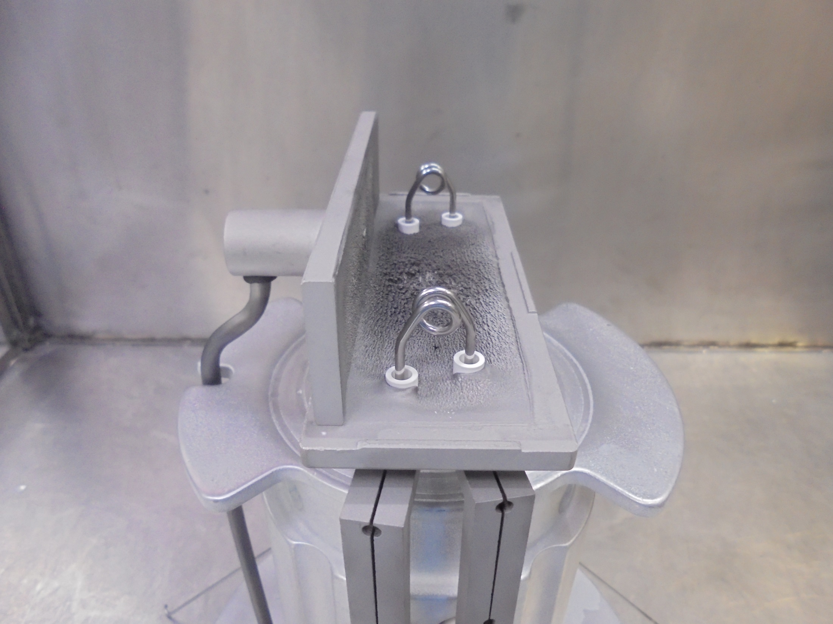
Install

Slide 34
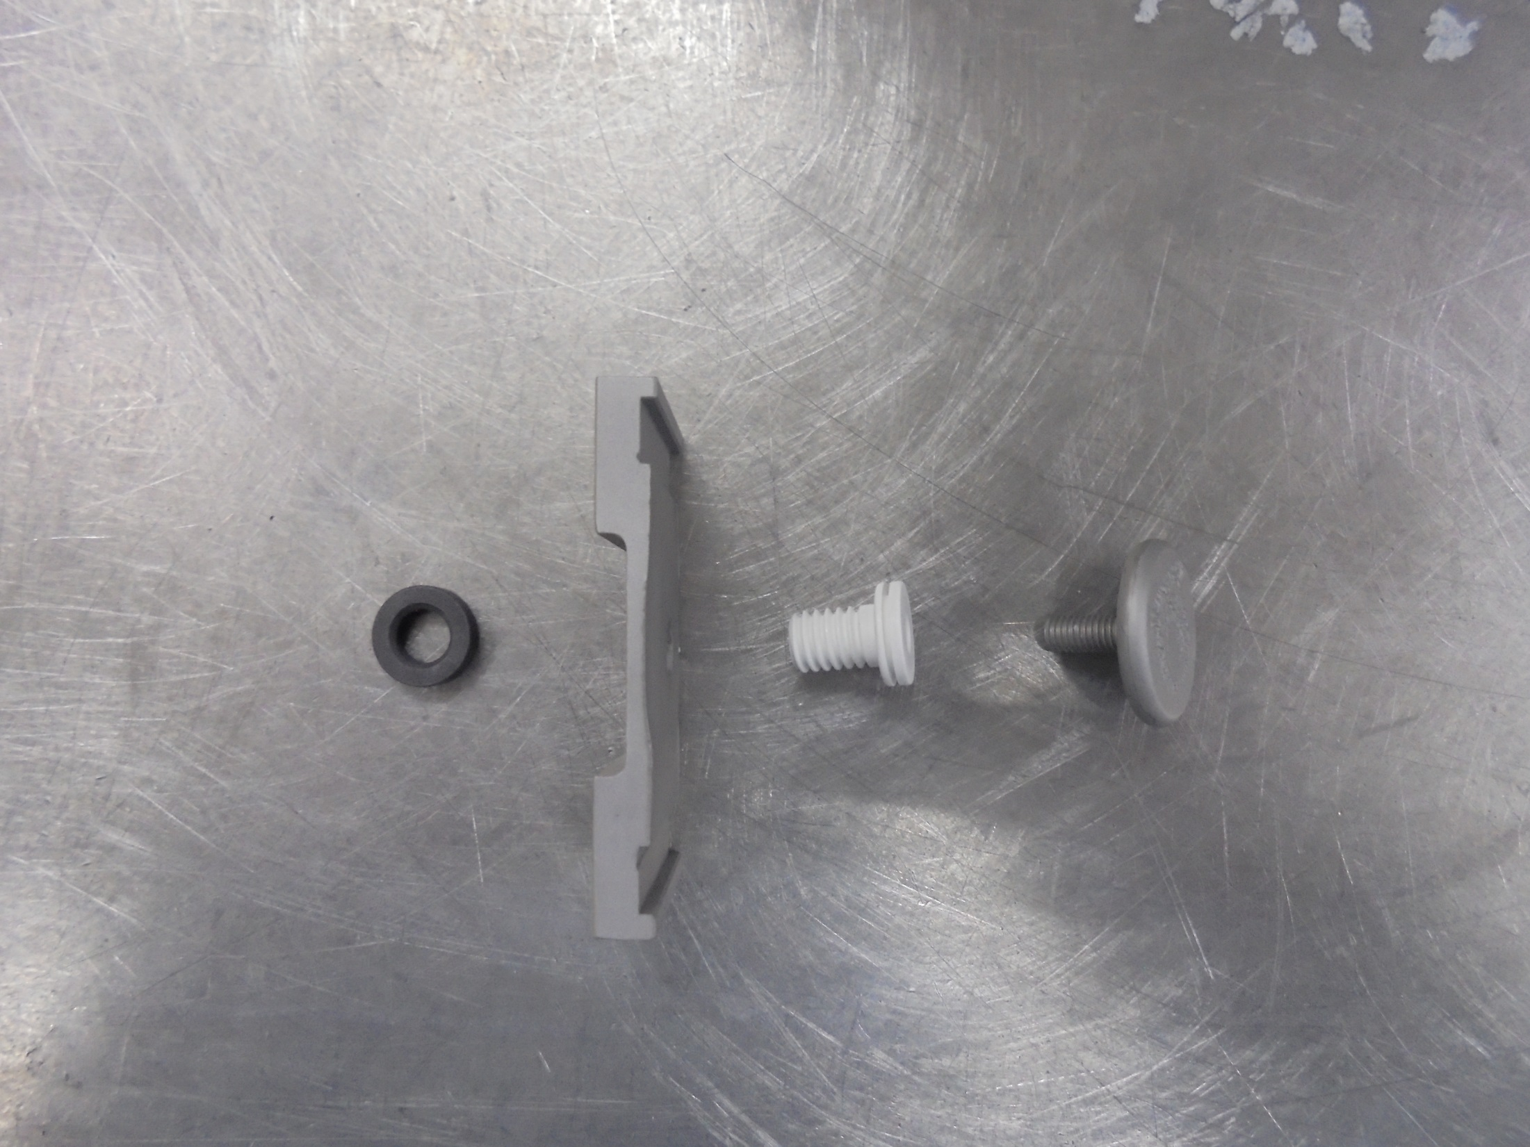
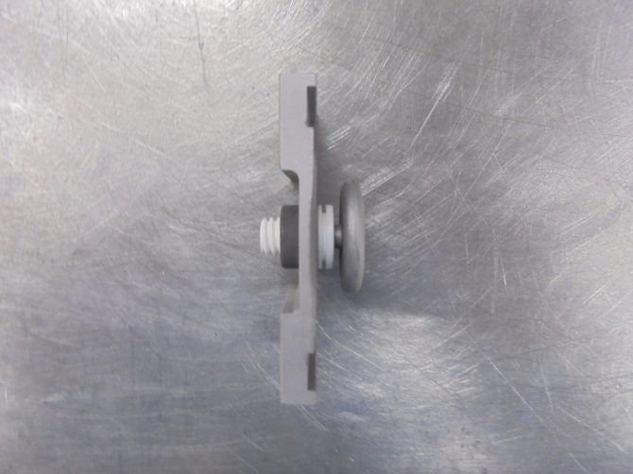
REPELLER END
*Assemble the Following Components

Slide 35
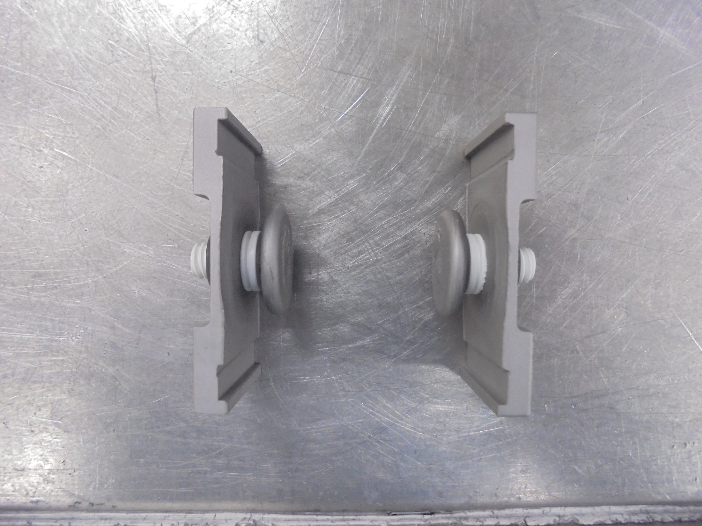
*2 REPELLER END

Slide 36
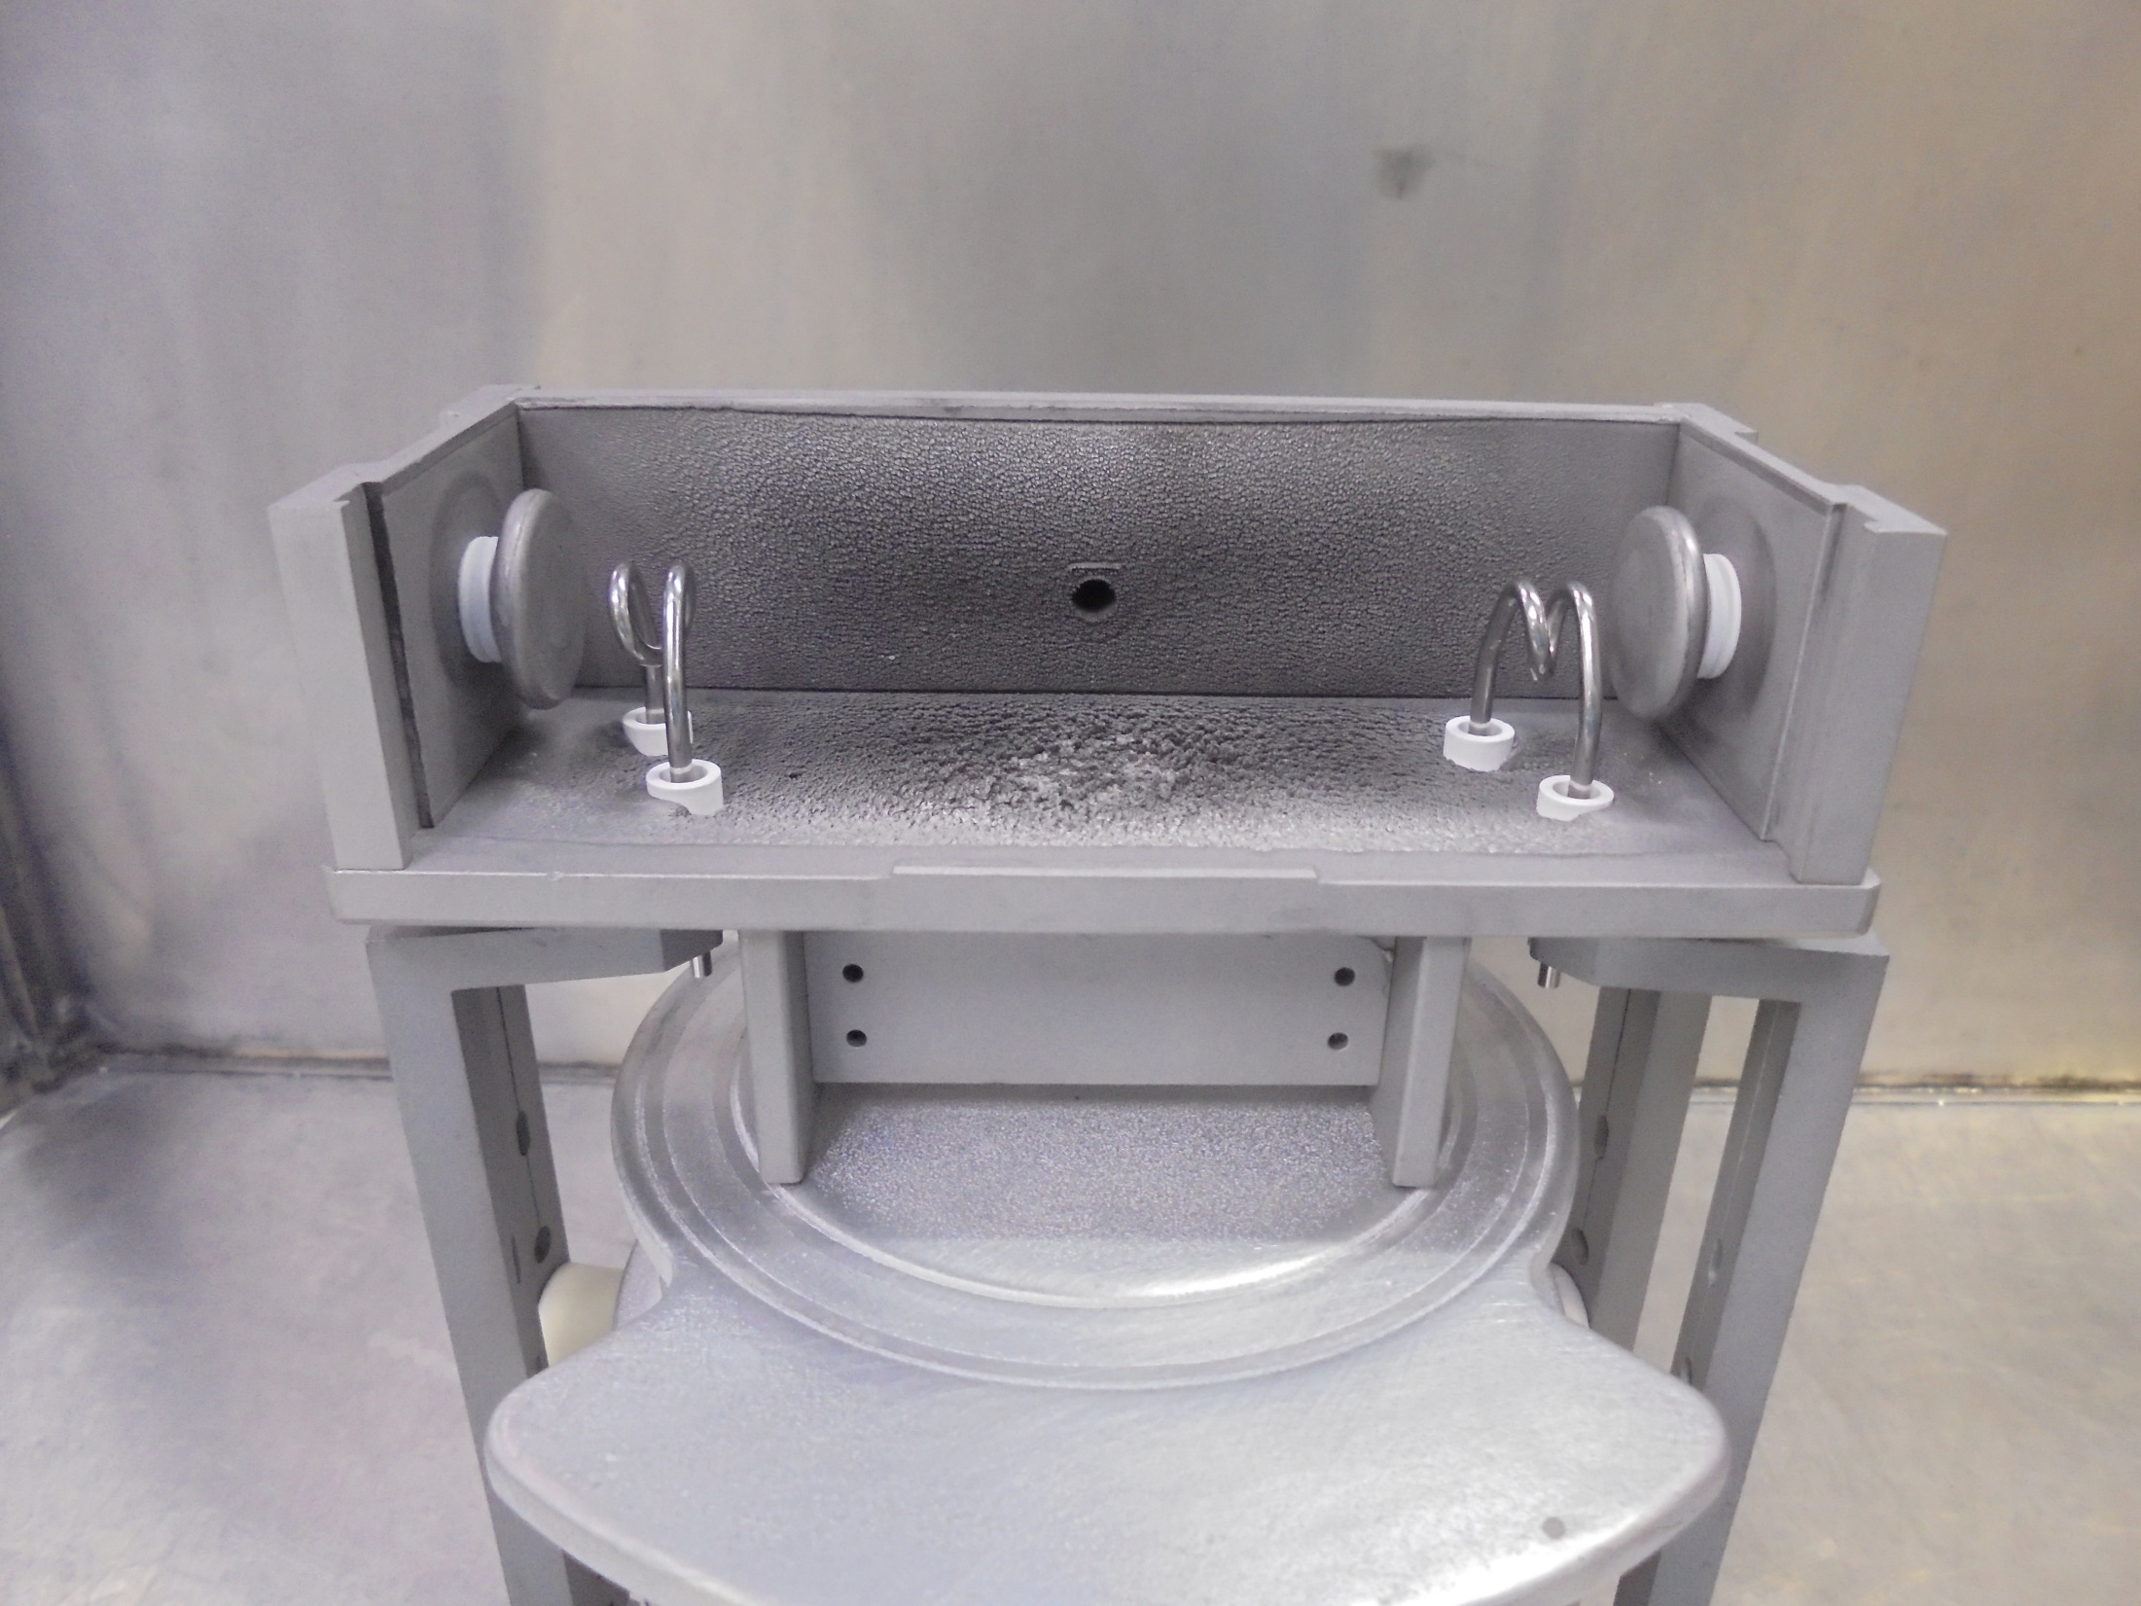
GAS HOLE
Carefully Install On Both Ends

Slide 37
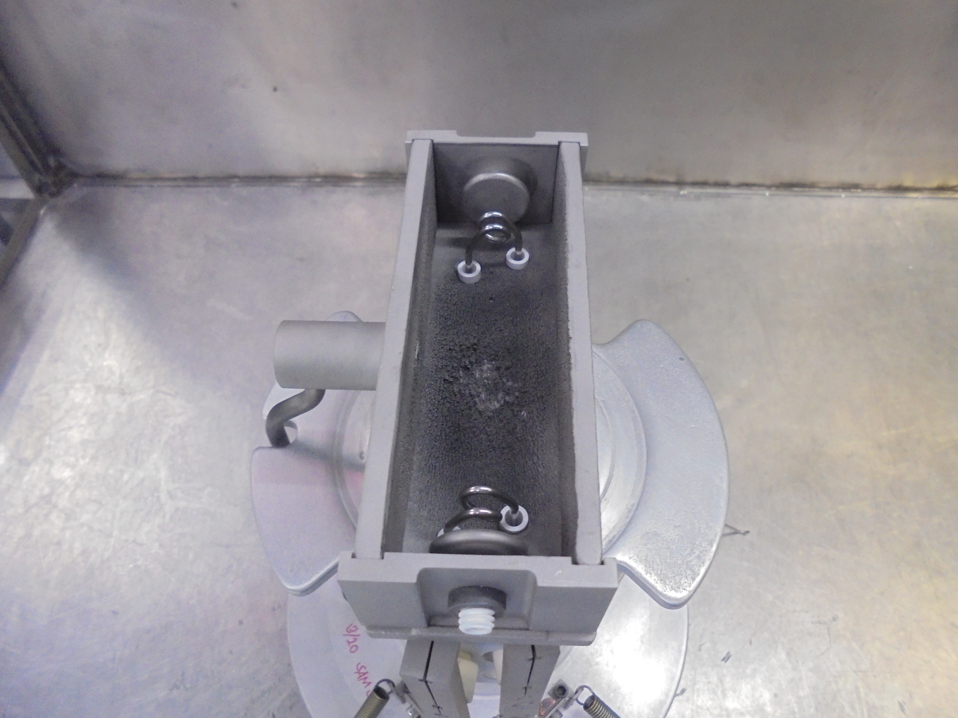
Install Other Side Plate

Slide 38
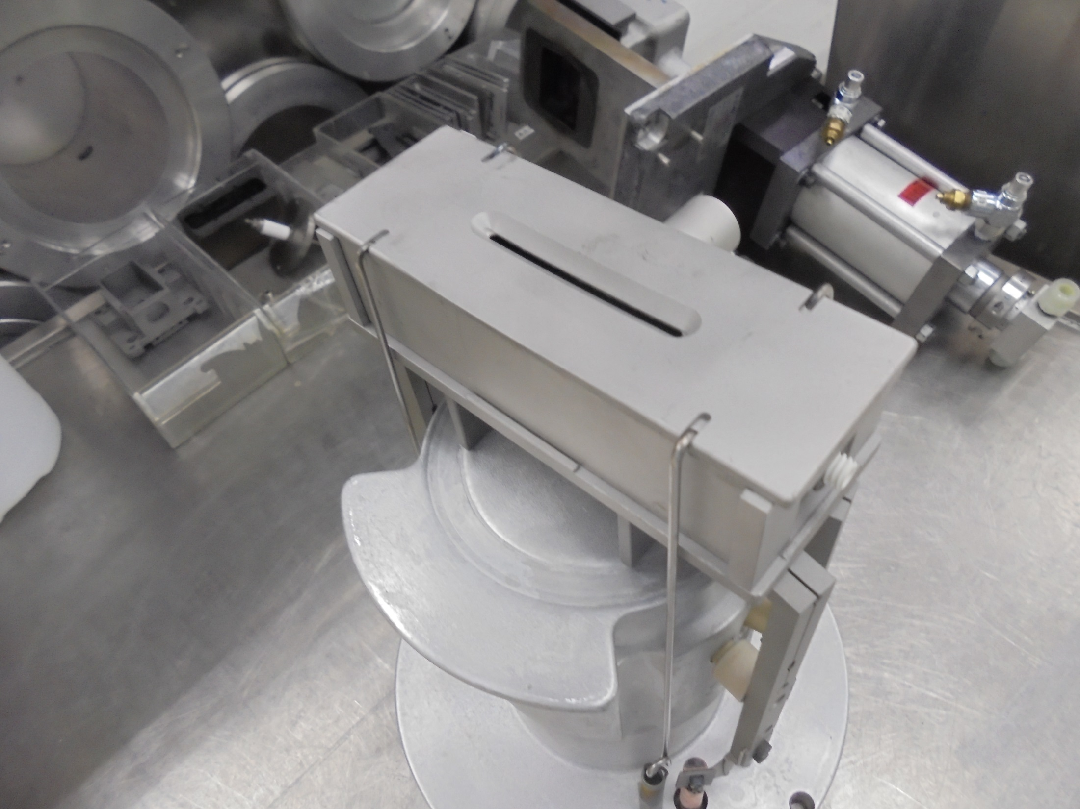
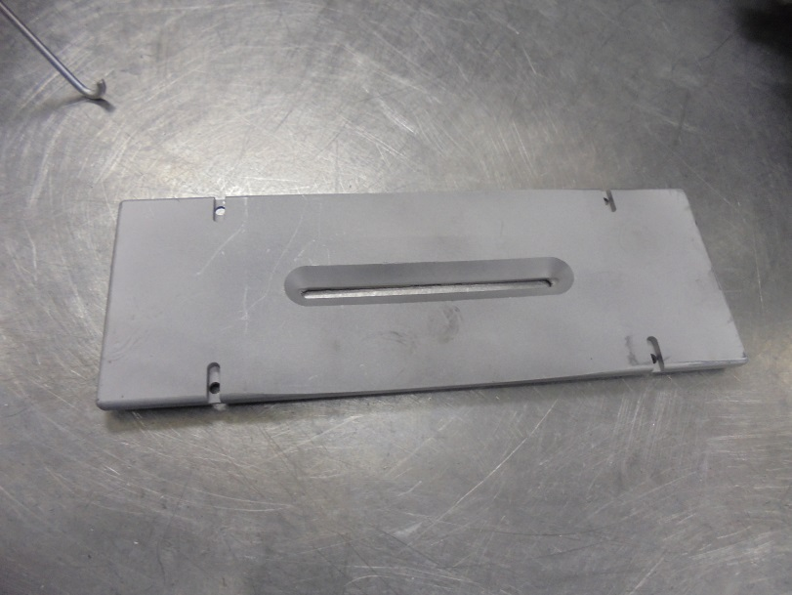
ARC SLIT/TOP PLATE

Slide 39
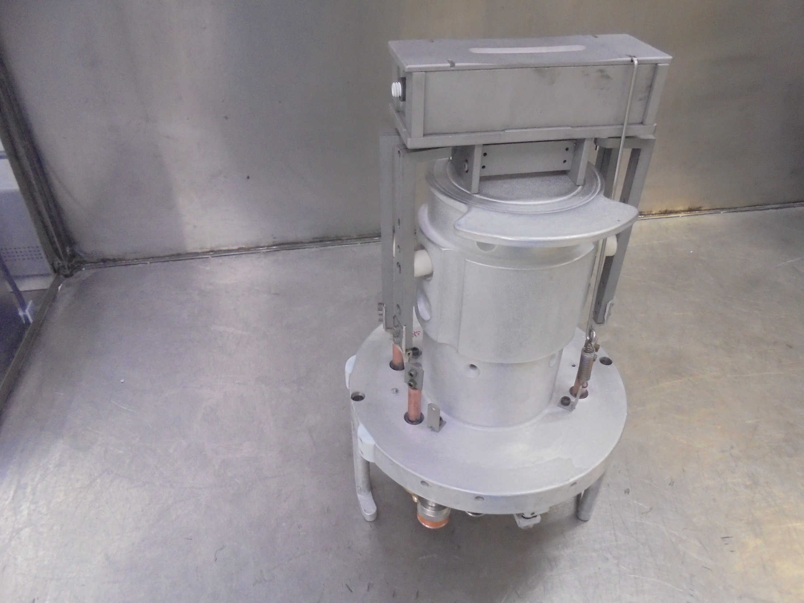
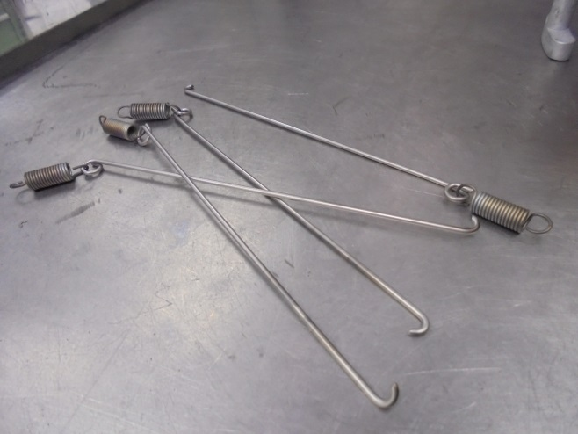
Install…
RETAINER HOOK

Slide 40
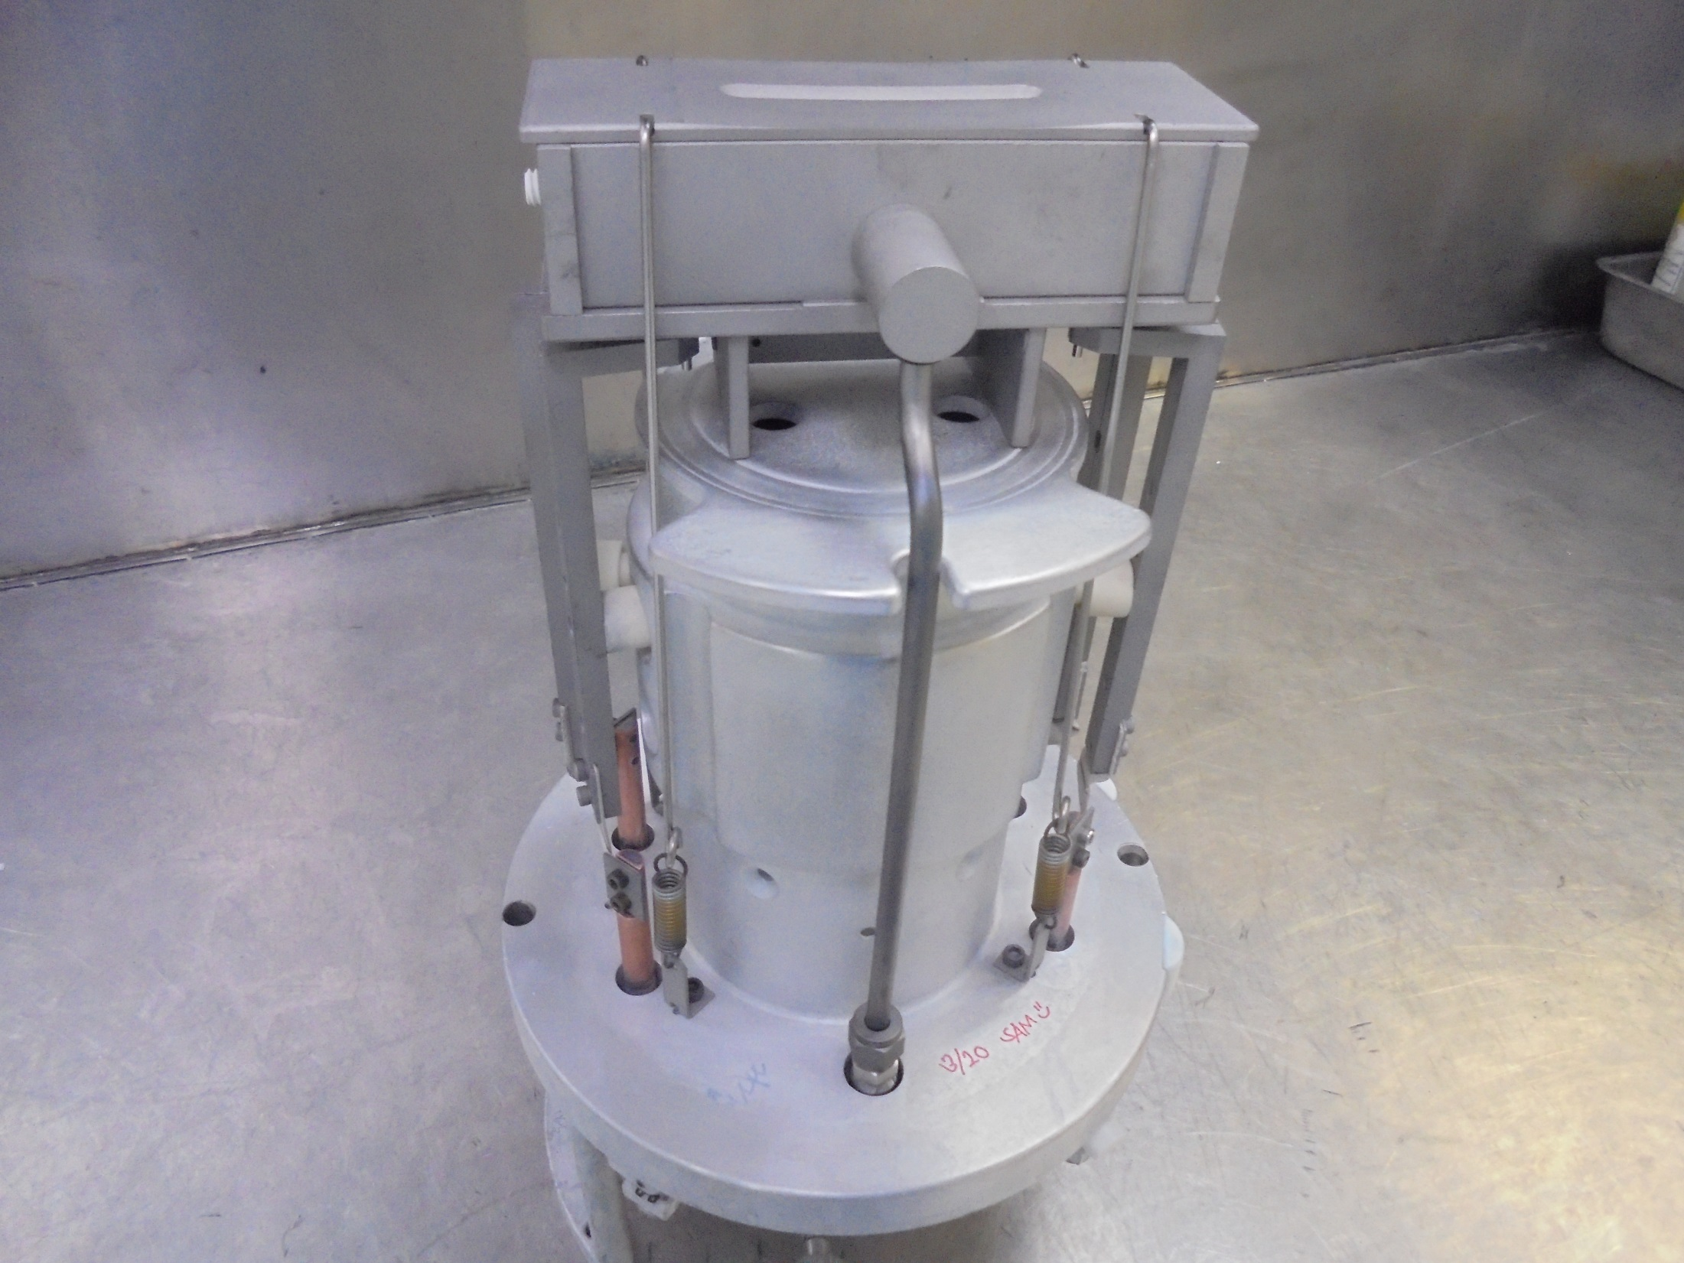
Secure 4
RETAINER HOOK
EXTENSION
SPRING
ANCHOR
EXTENSION
SPRING

Slide 41
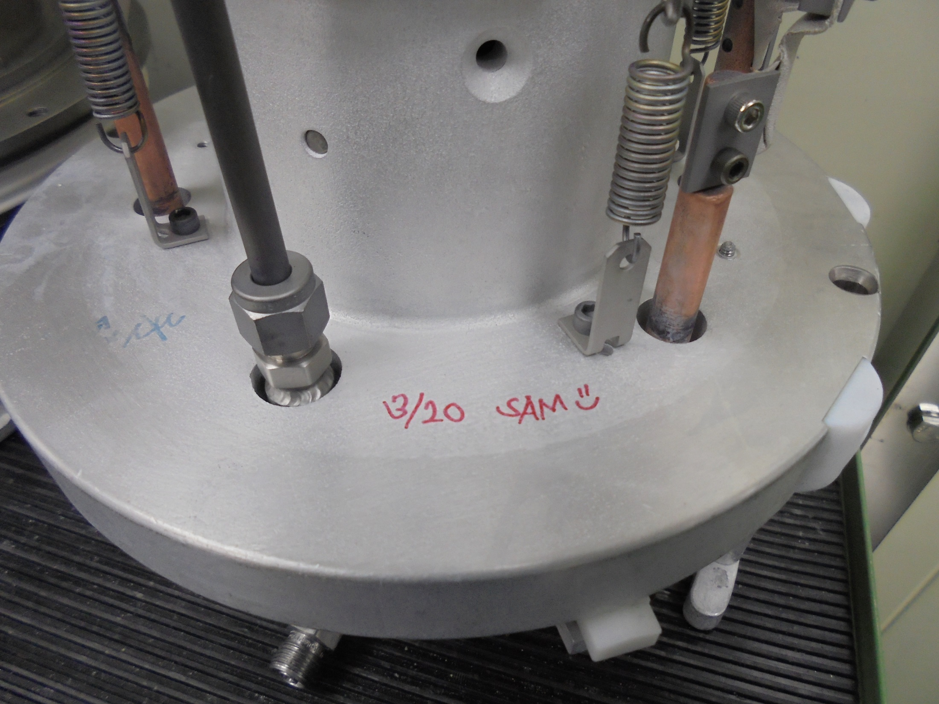
MAINTENANCE ASSEMBLY DONE.
Sign Name and Date.

Slide 42
-END-

